Slide 1
Medicare Advantage Special Needs Plans (SNP) Model of Care Training
CY 2022

Slide 2
SNP Model of Care Training Requirement
The Centers for Medicare & Medicaid Services (CMS) requires Bright Health employees, contractors and providers who serve Medicare Advantage Special Needs Plan (SNP) members to complete annual training on the SNP Model of Care (MOC)
The MOC provides the framework for how the SNP will identify and address the unique needs of its members
Annual MOC training ensures that relevant providers and staff are educated, aware and will leverage the SNP MOC to deliver care and services to SNP members

Slide 3
Objectives
Provide an overview of Medicare Advantage Special Needs Plans (SNPs)
Review SNP eligibility requirements
Review key SNP benefits for CY 2022
Review components of the SNP Model of Care (MOC)
Review the provider’s role in the SNP MOC
Review components of the SNP MOC program evaluation
Provide links to additional resources
Complete training attestation

Slide 4
SNP Overview

Slide 5
What is a Special Needs Plan (SNP)?
A type of Medicare Advantage Plan that focuses on certain vulnerable groups of Medicare beneficiaries
SNPs must implement additional clinical and care coordination services to meet the special needs of members
There are three types of SNPs:
Dual Eligible SNPs
(D-SNPs)
Enroll beneficiaries eligible for both Medicare and some level of Medicaid
Chronic Condition SNPs
(C-SNPs)
Enroll beneficiaries with certain chronic or disabling conditions
Institutional SNPs
(I-SNPs)
Enroll beneficiaries who are institutionalized or require an institutional level of care

Slide 6
Bright HealthCare CY 2022 SNPs
In 2022, Bright HealthCare is offering:*
Dual Eligible SNPs (D-SNPs) in CA, CO, and NY
Chronic Condition SNPs (C-SNPs) (two types)
Diabetes, Congestive Heart Failure & Cardiovascular Disease C-SNPs: AZ, CA, CO, FL & NY
Chronic & Disabling Mental Health Conditions (Chronic MH) C-SNP: AZ & CA only
Dementia C-SNP: CA only
State | D-SNP | DM/CHF/CVD C-SNP | Chronic MH C-SNP | Dementia C-SNP
Arizona** |  | X | X
California | X | X | X | X
Colorado** | X | X
Florida** |  | X
New York | X | X
*See Appendix for H-contract – PBP numbers and Plan names
**All SNPs new for CY 2022

Slide 7
What is a D-SNP?
A Medicare Advantage (MA) plan available to individuals eligible for both Medicare and Medicaid
Enrollees must:
Medicare coverage is primary; Medicaid coverage supplements Medicare coverage
Some D-SNPs are “integrated,” meaning they administer Medicare and Medicaid benefits
Note: All D-SNPs must assist members with accessing both Medicare and Medicaid benefits, even if the D-SNP does not administer the Medicaid benefit
Be entitled to Medicare Parts A (hospital) and B (medical) and eligible for Part D (drugs)
Be eligible for full Medicaid benefits or assistance with Medicare premiums or cost-sharing through a Medicare Savings Program (e.g., Qualified Medicare Beneficiary (QMB) Program)
Reside in the D-SNP’s service area

Slide 8
What is a C-SNP?
An MA plan available to individuals with certain chronic and disabling conditions
CMS has identified 15 chronic conditions that can be the focus of a C-SNP:
C-SNPs may focus on one chronic condition or a group of commonly co-morbid and clinically-linked conditions (e.g., diabetes, congestive heart failure & cardiovascular disease)
Chronic Alcohol & Other Drug Dependence
Certain Autoimmune Disorders
Cancer
Certain Cardiovascular Disorders (CVD)*
Congestive Heart Failure (CHF)*
Dementia*
Diabetes Mellitus*
End-Stage Liver Disease
End-Stage Renal Disease (ESRD) requiring dialysis
Certain Severe Hematologic Disorders
HIV/AIDS
Certain Chronic Lung Disorders
Certain Chronic & Disabling Mental Health Conditions*
Certain Neurologic Disorders
Stroke
*Focus of Bright Health 2022 C-SNPs

Slide 9
SNP Eligibility & Enrollment

Slide 10
CY 2022 D-SNPs: Medicaid Eligibility Requirements
To enroll in a D-SNP, must be eligible for both Medicare and Medicaid. The D-SNP chooses the eligible types of Medicaid coverage.
Bright HealthCare NY and CO D-SNPs are open to Medicare beneficiaries whose Medicaid coverage is:
Qualified Medicare Beneficiary (QMB); or
Qualified Medicare Beneficiary Plus (QMB-Plus); or
Full Medicaid Only (Other Full Benefit Dual Eligible or FBDE)
CA Only – requires Medicaid coverage
Bright Health must verify a member’s Medicaid eligibility before processing the enrollment and on a monthly basis thereafter

Slide 11
CY 2022 D-SNPs: Medicaid Eligibility Requirements
A member’s Medicaid coverage tells you the type of Medicaid benefits or assistance they receive
Bright HealthCare D-SNPs only enroll beneficiaries with QMB, QMB+ or Full Medicaid Only coverage
Bright HealthCare is responsible for covering Medicare covered services and supplemental benefits offered under the D-SNP. Members receive their Medicaid coverage through a Medicaid managed care plan and/or Medicaid fee-for-service.
Qualified Medicare Beneficiary (QMB)*
Medicaid covers Medicare Part A and B premiums, deductibles, coinsurance and copayment amounts
Qualified Medicare Beneficiary Plus (QMB+)*
Medicaid covers Medicare Part A and B premiums, deductibles, coinsurance and copayment amounts
Full Medicaid Only
(Other Full Benefit Dual Eligible or FBDE)
Eligible for full Medicaid benefits but not for the QMB program
Not otherwise eligible for any Medicaid benefits
Also eligible for full Medicaid benefits, secondary to Medicare coverage
Generally, cost share is $0 when the service is covered by both Medicare and Medicaid. May be instances where member must pay Medicare cost-sharing if service/benefit not covered by Medicaid.
Medicaid may provide some assistance with Medicare cost-sharing
*Providers may never collect Medicare cost-sharing for Parts A and B services from D-SNP members with QMB status. Federal law exempts QMB members from Medicare cost-sharing liability & forbids Medicare providers from billing members for such.

Slide 12
D-SNP Billing
Medicare is the primary payer for services covered by both Medicare and Medicaid. Medicaid is always payer of last resort.
For Medicare covered services:
First, bill Bright HealthCare
Second, bill Medicaid for Medicare cost-sharing, as applicable
QMB & QMB+ D-SNP Members: Have Medicare cost-sharing protection – should bill Medicaid for Medicare Part A and B deductibles, copayments and coinsurance. May not collect any Medicare cost-sharing from member- must accept Medicaid payment as payment in full even if payment is for less than the full Medicare cost-share amount.
Other FBDE D-SNP Members: Medicaid typically covers Medicare cost-sharing. May not collect any Medicare cost-sharing from member that is the responsibility of the State to pay. Member may have to pay Medicare cost-sharing if the benefit/service is not covered by Medicaid.
If D-SNP member has full Medicaid benefits, bill Medicaid for any services covered only by Medicaid
Note: Providers must participate in Medicaid in their state to be able to bill Medicaid for Medicare cost share reimbursement. If you do not participate in Medicaid, you give up your ability to seek the secondary payer reimbursement for a D-SNP member.

Slide 13
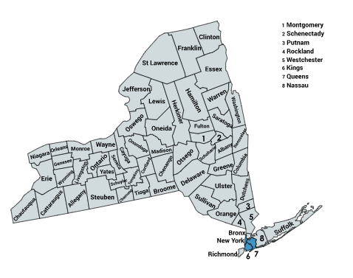
CY 2022 Bright HealthCare D-SNP Service Areas
Colorado
New York

Slide 14
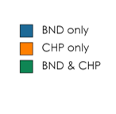
CY 2022 Bright HealthCare D-SNP Service Areas
California
New York

Slide 15
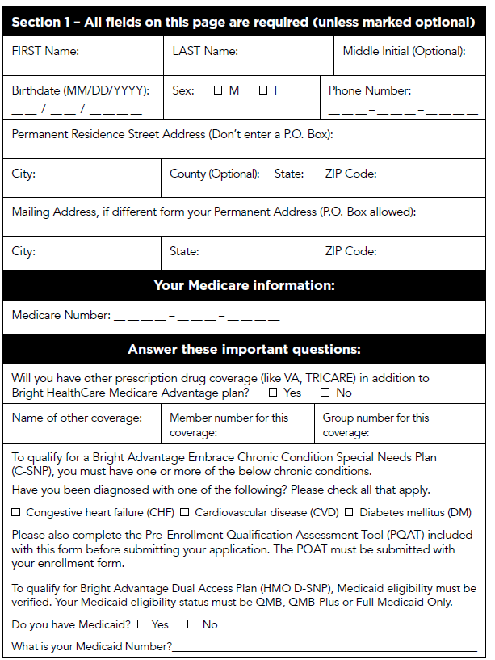
D-SNP Enrollment Process
Applicant completes D-SNP enrollment form
Similar to other MA enrollment forms
Difference: Asks about Medicaid eligibility
Enrollment must verify Medicaid eligibility before processing enrollment

Slide 16
Diabetes, Heart Failure & Cardiovascular C-SNPs (“Embrace” Plans)
To enroll in a C-SNP, the member must have a qualifying chronic condition
Bright HealthCare Diabetes, Heart Failure & Cardiovascular C-SNPs are open to members with one or more of the following conditions:
Diabetes Mellitus (not pre-diabetes)
Congestive or Chronic Heart Failure (CHF)
Cardiovascular Disorder (CVD) – must be one of the following CVDs:
Cardiac arrythmias
Coronary artery disease
Peripheral vascular disease
Chronic venous thromboembolic disorder
All DM/CHF/CVD C-SNPs have “Embrace” in the plan name

Slide 17
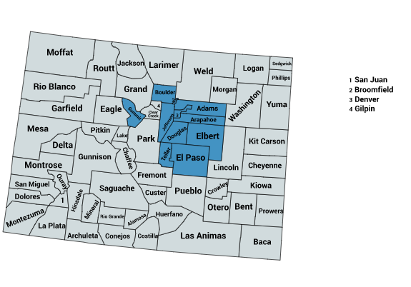
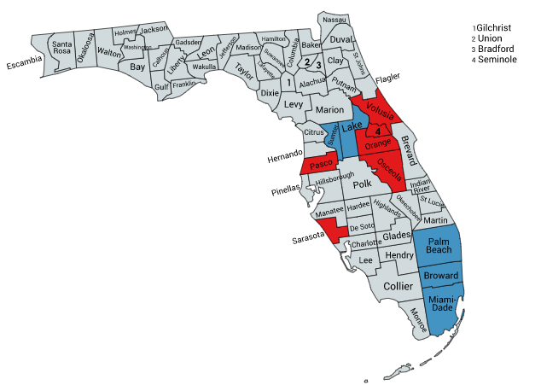
CY2022 Bright HealthCare DM/CHF/CVD C-SNP Service Areas
Colorado
California
New York
 | BND & CHP
 | BND only
Arizona
Florida
 | 2022 BHC-MA SNP Service Area
 | 2022 BHC-MA Non-SNP Service Area

Slide 18
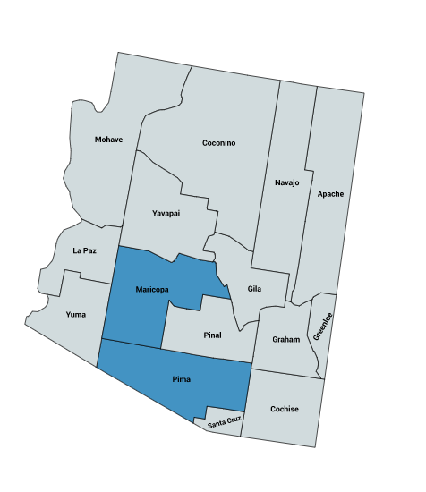
Chronic & Disabling Mental Health C-SNP
Our Chronic & Disabling Mental Health C-SNP (Chronic MH C-SNP) is open to members with one or more of the following conditions:
Major Depression
Bipolar Disorder
Schizophrenia
Schizoaffective Disorder
Paranoid Disorder
Available in CA and AZ only

Slide 19
Dementia C-SNP
In CA, Brand New Day offers a C-SNP for those diagnosed with dementia. It is offered in the following counties:
Fresno
Imperial
Kern
Los Angeles
Madera
Orange
Riverside
Sacramento
San Bernardino
San Diego
San Francisco
San Mateo

Slide 20
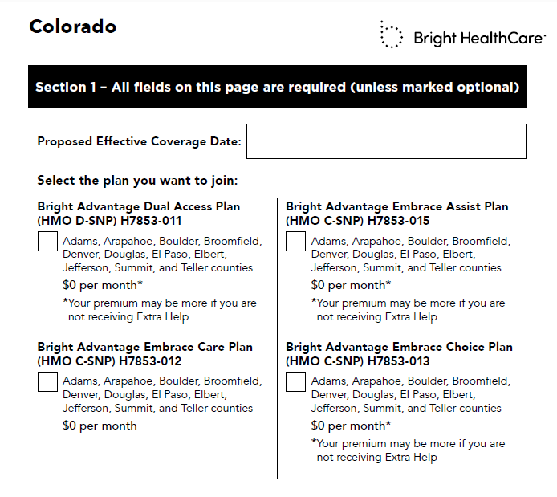
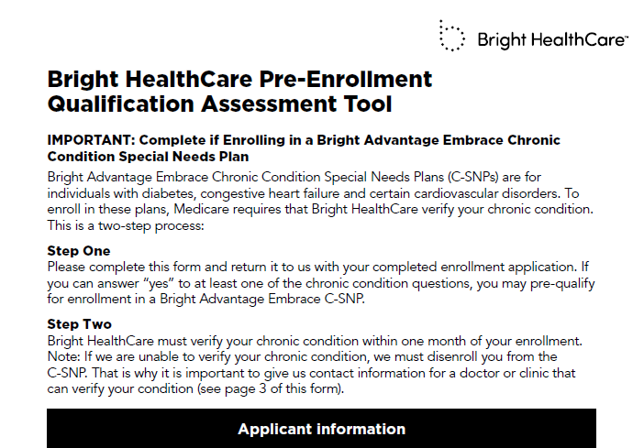
C-SNP Enrollment Process
Beneficiary completes C-SNP application (2 key pieces):
Enrollment Form
Similar to other MA enrollment forms
Difference: Asks about C-SNP qualifying condition
Pre-enrollment Qualification Assessment Tool (PQAT)
More detailed questions about the C-SNP qualifying conditions
Beneficiaries indicate if they have one of the conditions
Also provide contact information for provider(s) who can verify the beneficiary’s chronic condition
May enroll a member based on the PQAT responses but must verify the member’s chronic condition within the first month of enrollment

Slide 21
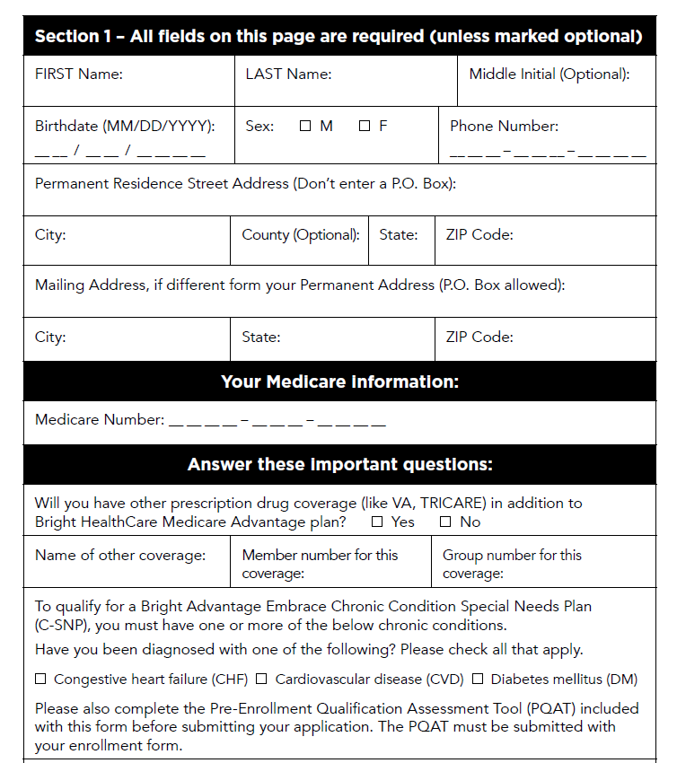
C-SNP Enrollment Form
One question on qualifying conditions
Instructs beneficiary to complete PQAT & submit with enrollment form

Slide 22
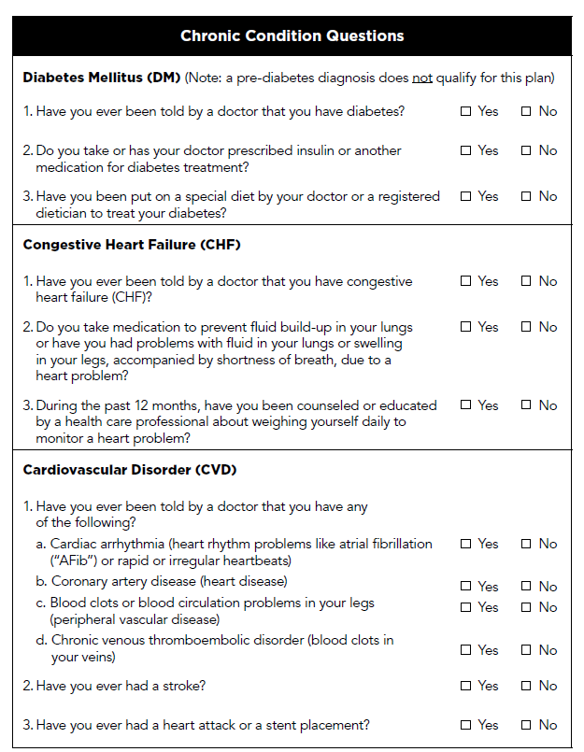
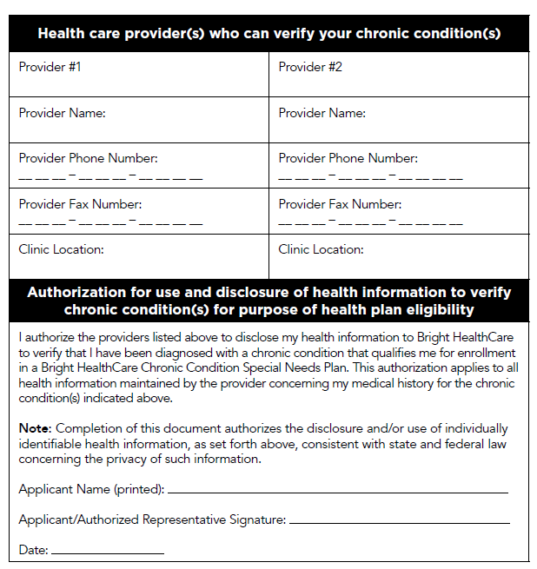
C-SNP Pre-Enrollment Qualification Assessment Tool (PQAT)
Chronic condition questions
Provider contact information
Authorization for provider to release information to Bright HealthCare
Example PQAT shown for DM/CHF/CVD C-SNP

Slide 23
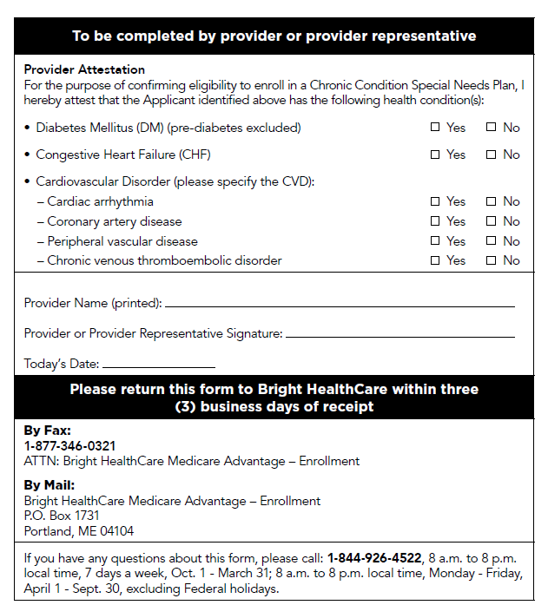
C-SNP Chronic Condition Verification
Must verify a member’s chronic condition by the end of the first month of enrollment
Allowable verification methods
Provider documentation/attestation (verbal or written)
CMS Model Output Report (MOR) identifies a qualifying diagnosis

Slide 24
C-SNP Chronic Condition Verification
If unable to verify a member’s chronic condition by the end of the first month of enrollment:
Must send member written notice within first seven calendar days of second month of enrollment
Notice must explain that if unable to verify chronic condition, member will be disenrolled at the end of the second month of enrollment
Will continue to try and obtain verification during the second month of enrollment
If successful, member may stay enrolled in C-SNP
If unsuccessful, member is disenrolled at end of second month and has SEP

Slide 25
2022 SNP Benefits

Slide 26
Bright HealthCare SNP Portfolio CY 2022
Assistance Level
Bright HealthCare designed its SNPs to meet the diverse needs of its member populations
CY2022 BHC-MA SNP Portfolio
 |  | No assistance | Partial assistance^{[1]} | Full assistance^{[2]}
C-SNPs^{[3]} | Diabetes, CHF and/or Cardiovascular Disease
 | Chronic & Disabling Mental Health Condition
 | Dementia
D-SNP | Dual-eligible
SNP Type
Embrace Care
Embrace Assist
Embrace Choice
Harmony Care
Harmony Choice
Bridges Care
Bridges Choice
Dual Access
SLMB beneficiaries in most states
QMB beneficiaries in most states
If chronic condition is diagnosed

Slide 27
CY 2022 BHC-MA product portfolio
Bright HealthCare is expanding its SNP portfolio to additional markets
Category | Product Name | AZ | CA | CO | FL | NY
D-SNP | Dual Access Plan | N/A | ✓ | ✓ | N/A | ✓
C-SNP | Embrace Care Plan (DM/CHF/CVD) | ✓ | ✓ | ✓ | ✓ | ✓
 | Embrace Assist Plan (DM/CHF/CVD) | ✓ | N/A | ✓ | ✓ | N/A
 | Embrace Choice Plan (DM/CHF/CVD) | ✓ | ✓ | ✓ | ✓ | ✓
 | Harmony Care Plan (SPMI) | N/A | ✓ | N/A | N/A | N/A
 | Harmony Choice Plan (SPMI) | ✓ | ✓ | N/A | N/A | N/A
 | Bridges Care Plan (Dementia) | N/A | ✓ | N/A | N/A | N/A
 | Bridges Choice Plan (Dementia) | N/A | ✓ | N/A | N/A | N/A
Notes: FL SNPs only in sub-markets with highly-aligned provider groups

Slide 28
CY 2022 Product Headlines
Key benefits and differentiators
Global Benefits | C-SNP Benefits | D-SNP Benefits
$0 PCP and urgent care | Personal nurse and care managers | Personal nurse and care managers
Worldwide emergency – includes transportation and urgent care | Senior Savings - $0 insulins | Large OTC Allowance
$0 T1/T6 through the gap + excluded drug coverage | Meals as Medicine – up to 168 meals available (except in AZ) | Meals as Medicine – up to 168 meals available
Embedded comprehensive dental, vision, and hearing | Healthy Foods Allowance | Healthy Foods Allowance
Member incentives | $0 endocrinologist visit | Unlimited transportation
Routine chiro/acupuncture | $0 blood pressure cuffs, scales, and CGMs | $0 blood pressure cuffs and scales

Slide 29
SNP Model of Care

Slide 30
What is a Model of Care (MOC)?
Unique CMS requirement for Special Needs Plans
All SNPs must develop and implement a MOC that has been approved by NCQA
The MOC provides the framework for how the SNP will identify and address the unique needs of its members
Overall goals of the MOC include:
Ensure access to affordable healthcare services
Ensure coordination of care across payers and care settings (e.g., coordination with Medicaid for D-SNP members)
Improve health outcomes
Reduce avoidable hospitalizations
Facilitate appropriate utilization of services

Slide 31
Bright HealthCare SNP Models of Care
Key Components
All SNP members:
Are assigned a Health Coach who is the member’s primary point of contact
Complete a Health Risk Assessment (HRA) to identify medical, psychosocial, behavioral, cognitive and functional needs
Have an Individualized Care Plan (ICP) that addresses the needs identified in the HRA
Have an Interdisciplinary Care Team (ICT) that helps manage the member’s care. The PCP plays a key role in the ICT.
Receive follow-up by a Bright HealthCare nurse after a transition of care (e.g., hospitalization, ER visit)

Slide 32
SNP Member Experience
Assigned Health Coach works with member throughout enrollment in SNP
HRA completed*
ICP developed*
ICT identified
ICP implemented
Member support during care transitions
ICP updated as needs change
*HRA & ICP completed upon enrollment & updated at least annually

Slide 33
Health Risk Assessment (HRA)
The HRA is a comprehensive assessment completed within 90 days of enrollment and at least annually thereafter (or sooner if there is a significant change in condition)
HRA assesses the member’s needs/risk in the following areas:
Medical
Psychosocial
Behavioral/Mental Health
Cognitive
Functional
HRA results drive development of the member’s Individualized Care Plan (ICP)

Slide 34
Individualized Care Plan (ICP)
All SNP members have an Individualized Care Plan (ICP)
ICP is driven by the HRA results
ICP contains member-specific needs, measurable goals and interventions. It addresses:
Member’s self-management goals & objectives
Member’s personal healthcare preferences
Member’s progress toward goals
Services & supports to meet the member’s needs
ICP assists Health Coach in coordinating services and supports specifically tailored to the member’s needs
ICP is shared with member, PCP and other members of ICT
ICP is dynamic document that is updated as the member’s needs change
All members must have an ICP, even if Bright HealthCare is unable to reach them or they refuse to participate in the HRA and ICP process
To obtain a copy of a patient’s ICP, email the Bright HealthCare MA Care Management Department at BrightMACM@brighthealthcare.com

Slide 35
Interdisciplinary Care Team (ICT)
Member
Health Coach
PCP
Specialist
Behavioral Health
Social Services
Home Health
BHC Medical Director
Pharmacy
Home & Community Based Providers
Each member is managed by an Interdisciplinary Care Team (ICT)
Composition of ICT depends on the member’s needs. PCPs are key participants.
Health Coach facilitates communication with ICT to address member’s needs, coordinate care and implement member’s Individualized Care Plan (ICP)

Slide 36
Providers’ Role in the Interdisciplinary Care Team (ICT)
Member
Health Coach
PCP
Specialist
Behavioral Health
Social Services
Home Health
BHC Medical Director
Pharmacy
Home & Community Based Providers
Review and contribute to the member’s Individualized Care Plan (ICP)
Offer expertise regarding the member’s medical needs
Communicate recommendations for preventive care and treatment
Work directly with the member to help make health care decisions
Work with the Bright HealthCare Health Coach, member and other ICT members to manage and coordinate the member’s care
Participate in ICT meetings

Slide 37
Member Support During Transitions of Care
When a SNP member experiences a transition in care (e.g., admitted to the hospital), a Bright HealthCare nurse helps coordinate care across settings and providers
Notifies member’s PCP of the transition
Reaches out to receiving setting to assist with coordination of care
Works with member throughout the transition to ensure needs are addressed
Ensures member understands discharge instructions and any medication changes
Facilitates follow-up appointments
Helps coordinate any needed services and supports
Educates member on new or existing conditions to help avoid readmissions
Updates ICP as necessary and shares with member, PCP & other members of ICT

Slide 38
Provider Role - Summary
Collaborate with the Bright HealthCare Health Coach on patients’ Individualized Care Plans (ICPs)
The Health Coach is the member’s primary point of contact and is responsible for communicating with the PCP and ICT:
At least annually
When any updates are made to the member’s HRA or ICP and/or after a member experiences a transition in care
Participate in the Interdisciplinary Care Team (ICT)
Encourage patients to work with their Bright HealthCare Health Coach
To contact a patient’s Health Coach or for additional information about care management services available to your patients, contact the Bright HealthCare MA Care Management Department:
Email: BrightMACM@brighthealthcare.com
Call: 888-668-0804

Slide 39
SNP MOC Evaluation

Slide 40
SNP Model of Care Evaluation
CMS requires SNPs to have a comprehensive quality program that evaluates the effectiveness of the MOC
For each of its SNPs, Bright HealthCare has identified process and outcome measures tied to four focus areas:
Access and affordability
Coordination of care and appropriate delivery of services
Care transitions
Appropriate utilization of services for preventive health and chronic conditions

Slide 41
SNP MOC Goals – Access & Affordability
Goal Focus Area | Desired Health Outcomes
Access and Affordability | Demonstration of members’ ability to access affordable care as evidenced by utilization data, including: PCP & specialty visits ER visits Hospital admissions Prior authorization turn-around time

Slide 42
SNP MOC Goals – Coordination of Care
Goal Focus Area | Desired Health Outcomes
Coordination of Care & Appropriate Delivery of Services via Alignment of HRA, ICP & ICT | Demonstration of alignment of the HRA, ICP and ICT as evidenced by: Timely completion of initial and annual HRAs Timely completion of ICP addressing member’s needs Timely review of HRA and ICP upon a member’s change in health status

Slide 43
SNP MOC Goals – Care Transitions
Goal Focus Area | Desired Health Outcomes
Care Transitions | Demonstration of supported care transitions across health settings and providers as evidenced by: Timely completion of visits between member and a Bright HealthCare nurse following a transition of care Hospital readmission rates Medication reconciliation post-discharge rates

Slide 44
SNP MOC Goals – Appropriate Utilization
Goal Focus Area | Desired Health Outcomes
Appropriate Utilization of Services for Preventive Health and Chronic Conditions | Demonstration of appropriate utilization of services for preventive health and chronic condition management as evidenced by rates on targeted HEDIS® and Star measures, including: Diabetes care and screening (e.g., HbA1c testing & control, eye exam, kidney monitoring) Blood pressure control Adherence to medications for chronic condition management (e.g., diabetes, hypertension)

Slide 45
BHC MOC Training Attestation
Thank you for completing the Bright Health SNP Model of Care Training
To acknowledge completion and receive credit, please click the link below to complete the MOC Training Attestation (hold control + click to follow link)
Bright Health SNP Model of Care Training Attestation Form (office.com)
Remember to hit “Submit” at the bottom of the attestation form to complete the Attestation

Slide 46
Brand New Day MOC Training Attestation
Thank you for completing the Bright Health SNP Model of Care Training
To acknowledge completion and receive credit, please click the link below to complete the MOC Training Attestation (hold control + click to follow link)
Brand New Day SNP Model of Care Training Attestation Form

Slide 47
Bright Health Care: To learn more
Additional Resources
NCQA Website: https://snpmoc.ncqa.org/about-the-program/
CMS Website: https://www.cms.gov/Medicare/Health-Plans/SpecialNeedsPlans
Questions? Email: The MA Care Management Mailbox: BrightMACM@brighthealthcare.com
Thank you for completing the Bright Health SNP Model of Care Training!

Slide 48
Brand New Day - To learn more
Additional Resources
NCQA Website: https://snpmoc.ncqa.org/about-the-program/
CMS Website: https://www.cms.gov/Medicare/Health-Plans/SpecialNeedsPlans
Questions? Please visit the Brand New Day website at www.BND.HMO.com for more information
Thank you for completing the Bright Health SNP Model of Care Training!

Slide 49
Appendix

Slide 50
CY 2022 Bright HealthCare SNPs
H-Contract - PBP | Plan Name | Service Area | State | Plan Type | SNP Type | SNP Detail
H4853-016-000 | Bright Advantage Embrace Care Plan (HMO C-SNP) | Phoenix and Tucson | AZ | HMO | C-SNP | DM/CHF/CVD
H4853-017-000 | Bright Advantage Embrace Choice Plan (HMO C-SNP) | Phoenix and Tucson | AZ | HMO | C-SNP | DM/CHF/CVD
H4853-018-000 | Bright Advantage Harmony Choice Plan (HMO C-SNP) | Phoenix and Tucson | AZ | HMO | C-SNP | Chronic MH
H4853-020-000 | Bright Advantage Embrace Assist Plan (HMO C-SNP) | Phoenix and Tucson | AZ | HMO | C-SNP | DM/CHF/CVD
H7853-011-000 | Bright Advantage Dual Access Plan (HMO D-SNP) | Greater Denver Area | CO | HMO | D-SNP | Dual
H7853-012-000 | Bright Advantage Embrace Care Plan (HMO C-SNP) | Greater Denver Area | CO | HMO | C-SNP | DM/CHF/CVD
H7853-013-000 | Bright Advantage Embrace Choice Plan (HMO C-SNP) | Greater Denver Area | CO | HMO | C-SNP | DM/CHF/CVD
H7853-015-000 | Bright Advantage Embrace Assist Plan (HMO C-SNP) | Greater Denver Area | CO | HMO | C-SNP | DM/CHF/CVD
H4709-027-000 | Bright Advantage Embrace Care Plan (HMO C-SNP) | Central Florida | FL | HMO | C-SNP | DM/CHF/CVD
H4709-031-000 | Bright Advantage Embrace Choice Plan (HMO C-SNP) | Central Florida, Fort Lauderdale, Miami-Dade, Palm Beach | FL | HMO | C-SNP | DM/CHF/CVD
H4709-033-000 | Bright Advantage Embrace Care Plan (HMO C-SNP) | Fort Lauderdale and Palm Beach | FL | HMO | C-SNP | DM/CHF/CVD
H4709-037-000 | Bright Advantage Embrace Care Plan (HMO C-SNP) | Miami-Dade | FL | HMO | C-SNP | DM/CHF/CAD
H4709-039-000 | Bright Advantage Embrace Assist Plan (HMO C-SNP) | Central Florida, Fort Lauderdale, Miami-Dade, Palm Beach | FL | HMO | C-SNP | DM/CHF/CVD
H2288-003-000 | Bright Advantage Dual Access Plan (HMO D-SNP) | New York City | NY | HMO | D-SNP | Dual
H2288-009-000 | Bright Advantage Embrace Care Plan (HMO C-SNP) | New York City | NY | HMO | C-SNP | DM/CHF/CVD
H2288-010-000 | Bright Advantage Embrace Choice Plan (HMO C-SNP) | New York City | NY | HMO | C-SNP | DM/CHF/CVD

Slide 51
CY 2022 Bright HealthCare SNPs
H-Contract - PBP | Plan Name | Service Area | State | Plan Type | SNP Type | SNP Detail
H0838-020-000 | Brand New Day Harmony Choice Plan (HMO C-SNP) | CA Broad 1 | CA | HMO | C-SNP | Chronic MH
H0838-024-000 | Brand New Day Dual Access Plan (HMO D-SNP) | CA Broad 2 | CA | HMO | D-SNP | Dual
H0838-028-000 | Brand New Day Bridges Care Plan (HMO C-SNP) | CA Broad 1 | CA | HMO | C-SNP | Dementia
H0838-029-000 | Brand New Day Bridges Choice Plan (HMO C-SNP) | CA Broad 1 | CA | HMO | C-SNP | Dementia
H0838-032-000 | Brand New Day Harmony Care Plan (HMO C-SNP) | CA Broad 1 | CA | HMO | C-SNP | Chronic MH
H0838-039-001 | Brand New Day Embrace Care Plan (HMO C-SNP) | CA South 1 | CA | HMO | C-SNP | DM/CHF/CVD
H0838-039-002 | Brand New Day Embrace Care Plan (HMO C-SNP) | CA Central 2 | CA | HMO | C-SNP | DM/CHF/CVD
H0838-040-001 | Brand New Day Embrace Choice Plan (HMO C-SNP) | CA South 1 | CA | HMO | C-SNP | DM/CHF/CVD
H0838-040-002 | Brand New Day Embrace Choice Plan (HMO C-SNP) | CA Central 2 | CA | HMO | C-SNP | DM/CHF/CVD
H5649-002-000 | Central Health Medi-Medi (HMO D-SNP) | Los Angeles and San Bernardino counties | CA | HMO | D-SNP | Dual
H5649-002-000 | Central Health Focus Plan (HMO C-SNP) | Los Angeles, Orange and San Bernardino counties | CA | HMO | C-SNP | DM/CHF/CVD
H5649-002-000 | Central Health Ventura Medi-Medi (HMO D-SNP) | Ventura county | CA | HMO | D-SNP | Dual

Slide 52
Colorado Medicaid Resources
Topic | Link
General Help | Get Help - Health First Colorado
Important Member Contacts | See Contact Us | Colorado Department of Health Care Policy & Financing Health First Colorado Member Contact Center: Tel: 1-800-221-3943; TTY 711; Fax: 303-866-4411. Hours: M – F, 8am – 4:30pm MT except for state holidays Health First Colorado Nurse Advice Line: 1-800-283-3221 (available 24 hours/day, 7 days per week, 365 days a year). For additional information and FAQs regarding the Nurse Advice Line, see Benefits & Services - Health First Colorado
Benefits & Services Overview | Benefits & Services - Health First Colorado
Pharmacy Benefits | See Health First Colorado Pharmacy Benefits | Colorado Department of Health Care Policy & Financing. Web page includes link to the Health First Colorado Preferred Drug List
Health First Colorado Member Handbook | Available in English and Spanish at Benefits & Services - Health First Colorado
Health First Colorado Find a Doctor Online Search Tool | Find a Doctor - Health First Colorado
Information on the Medicare Savings Programs (e.g., QMB & QMB+) | Medicare Savings Programs (MSP) | Colorado Department of Health Care Policy & Financing
Member FAQs | Member Frequently Asked Questions | Colorado Department of Health Care Policy & Financing Web page includes FAQs on multiple topics, including: Health First Colorado: Frequently Asked Questions - Health First Colorado Health First Colorado Pharmacy Benefits: Health First Colorado Pharmacy Benefits Frequently Asked Questions - Health First Colorado
Home and Community Based Services (HCBS) Waivers | Long-Term Services and Supports Programs | Colorado Department of Health Care Policy & Financing
Health First Colorado is the Colorado Medicaid Program
The Colorado Dept. of Health Care Policy & Financing (the State Medicaid Agency) has many resources on its website at https://www.healthfirstcolorado.com

Slide 53
New York Medicaid Resources
The New York State Department of Health (SDOH) is the New York State Medicaid Agency
The SDOH website is not as robust as Colorado’s Medicaid website but does have some helpful information.
Topic | Link
Medicaid Consumer Medicaid Helpline | 1-800-541-2831. See Medicaid Program Important Phone Numbers - New York State Department of Health (ny.gov)
Local Departments of Social Services (by county) Contact Information | Local Departments of Social Services - New York State Department of Health (ny.gov)
Medicaid FAQs & Fact Sheets | Medicaid (ny.gov)
Information on Medicaid Managed Long Term Care (MLTC) | See Managed Long Term Care (MLTC) (ny.gov). Web page includes links to Member Handbooks and Provider Directories for Medicaid MLTC health plans. Bright HealthCare D-SNP members may also be enrolled in a Medicaid MLTC plan.
Provider & Health Plan Search Tool | NYS Provider & Health Plan Look-Up Tool

Slide 54
California Medi-Cal Resources
Topic | Link
Medicaid Consumer Medicaid Helpline | ​1-800-541-5555 See: Medi-Cal Member and Provider Hotline
Local Departments of Social Services (by county) Contact Information | California Department of Public Health
Information on Medicaid Managed Long Term Care (MLTC) | https://www.medi-cal.ca.gov/
Provider & Health Plan Search Tool | CA Provider & Health Plan Search Tool
In home support services | Search the county website to find the nearest in-home support services. You can apply online or call to learn more.

