Slide 1

Special Needs Plans Model of Care
Annual Training
Brand New Day SNP MOC Training

Slide 2
Topics to be Covered
Overview – What are SNPs?
Embrace SNP (Diabetes, CHF, and Cardiovascular Diseases)
DSNP- Dual eligible with Medi-Cal
Bridges C-SNP Plans for Dementias
I-and IE-SNP Plans for those residing in Nursing Homes, RCFE’s, and the Homebound

Slide 3
Topics to be Covered (cont)
Transition of Care
Pharmacy 101
Harmony SNP (Mental Illnesses)
SAC Program (Semi-Acute Care Transitions)
SNP Compliance Requirements

Slide 4
What is a SNP?
A SNP is a “Special Needs Plan” designed for beneficiaries that must qualify.
Qualifications required depend on the type of SNP.

Slide 5
Types of SNPs?
D-SNP is a SNP designed for Dual Eligible members.
C-SNP is a chronic care SNP designed for specific chronic conditions.
I-SNP is an “Institutional” SNP for members that live in skilled nursing facility. The IE-SNP is the “Institutional Equivalent” for members that receive extra care either in an Assisted Living Facility or at home, so they do not have to reside in a skilled nursing facility.

Slide 6
Qualifications to Enroll
D-SNP - must be Medi-Medi.
C-SNP “Embrace” - must have diagnosis of CHF, CVD, or Diabetes
C-SNP “Bridges” - must have diagnosis of a type of Dementia
C-SNP “Harmony” – must have a severe and persistent mental illness
I-SNP – “Select Care” Must be institutionalized.

Slide 7
SNP Management
Medical Director
  Oversees the programs & directors
Program Directors
  Oversee programs on a daily basis
Health Coaches
  Work with members of C-SNPs & I-SNP
Life Coaches
  Work with Mental Illness C-SNP members

Slide 8
Supplemental Staff
FINs
  Field Intervention Nurses visit members in their homes to teach, provide care, including transition of care
Activity Center Staff
  Mental Illness SNP members have an activity center available with staff leading groups, providing recreation, and assisting members in scheduling appointments, etc.

Slide 9
Member care philosophy
“Health care” not “sick care”
Evidence-based care yields better outcomes
Managed care gives higher quality and lower cost
Effective partnership is essential
Healthcare is a people business
Healthcare is a local business
We match care desired to care given
You can achieve profits by keeping members healthy and happy!
We believe… So we invested in…
Information Technology
Team Alignment
Accountability Tools
Timely, Accurate, Transparent Data
Patient & Provider Portals
Medical Management
Culture of Innovation

Slide 10
AI-Powered Risk Stratification & Intervention Planning
Cost of Care by Population Cohorts
20%
25%
55%
50%
30%
20%
Complex care management, multiple chronic conditions, persistently high cost
High Risk – unstable
High Risk – stable
Complex Case Management
Focused care management
5%
50%
Care Coordination, wellness activities
35%
Multiple chronic conditions
Mover
20%
75%
15%
Wellness activities, education
Asymptomatic / early onset chronic condition
Low Risk
% Population
% Cost of care
Notes:
Top of pyramid needs to have text resized or made to be legible

Slide 11
Chronic care support programs
BND completes individual care plans (ICP) for its members under the direction of the Plan Medical Director.
PCPs will receive copies of the ICPs. ICPs may include treatment recommendations from our medical directors. PCPs are asked consider these recommendations when preparing treatment plans.
The ICPs follow the BND 7 Fundamentals of Chronic Care Management and is meant to support our doctors in treating members’ chronic conditions.

Slide 12
7 Fundamentals of Chronic Care Management
Brand New Day has developed 7 areas to be addressed in each member’s Individual Care Plans (ICP) in addition to any treatment recommendations provided to the PCP.
Education
Nutrition
Exercise
Medication Adherence
Self Testing
Preventative Health
Community Linkages

Slide 13

Embrace CSNP Plan

Slide 14
The BND Diabetic, CHF and CV Disease Program
Special program that supports Diabetic and/or CHF or CV disease Medicare beneficiaries
The program provides additional support to the member, caregiver and family, and provider to assist managing the members diabetes
14

Slide 15




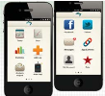
The Ecosystem for BND Diabetes Program
Cellular Diabetic
Meter
T
Wireless
BGM
Monitoring & Support
By 24 hour Care Team
Of Certified Diabetic
Educators
Home Delivery
Tracking by Usage
DME & Rx
Delivery
Telserve
Secure Cloud
Database
Education
Library
Mobile
Apps
Care Team Portals
PCP/IPA Care Manager
Website
As part of the
Member Portal
Intervention
& Coaching
Patient
Portal
Health Coaches to
Support member,
Caregiver, PCP &
IPA. Develops ICP
Smart Phone
Interface
BND Member Diabetic
Website
15

Slide 16
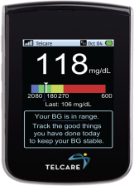
Telcare Diabetic Meter
Sophisticated technology with a personalized approach
Telcare developed the first FDA-cleared cellular blood glucose meter. And along the way, learned that the simpler and more effortless the technology, the more often people will use it.
No charge to members for meter or supplies.
16

Slide 17
The freedom of Cellular connectivity
Telcare isn’t Wi-Fi dependent, so there’s no searching for networks, asking for passwords, or giving up. There’s no need for users to have a cell phone, app, USB cords or additional hardware. Patients don’t even have to enter data, since Telcare does it automatically anywhere it has cellular connectivity. And there are no data transmission charges.
17

Slide 18
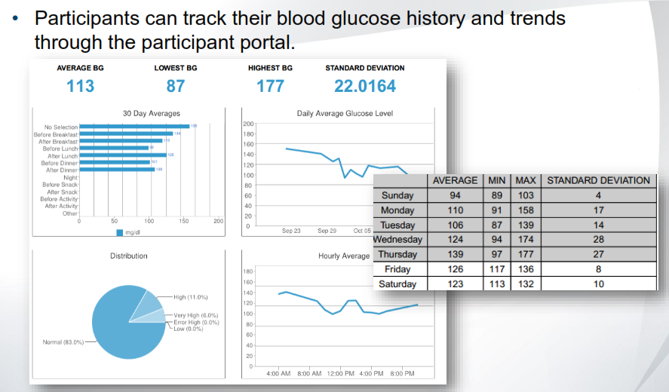
Patient Portal
Patient Portal
18

Slide 19
Health Coach
Personalized Coaching to support the member, PCP, and family manage their diabetes.
Develop short term and long term goals to better manage patients diabetes.
Patient Individual Care plans (ICP) uses the BND’s 7 Fundamentals of Chronic Care to develop consistent complete ICP
  Disease Education including complications
  Nutrition
  Exercising
  Self Testing
  Medication Adherence
  Preventative Care Plan
  Community Linkage
19

Slide 20
Health Coach
Health Coaches can also do home visits if needed to teach glucometer use & assess home situations
Health Coaches attend Health Fairs to assist with educating members & answering questions
Health Coaches complete Transition of Care calls and home visits to prevent readmissions.

Slide 21
Diabetes Care Partners
Diabetes Education by Certified Diabetes Educators and Registered Dieticians
Done in 3 ways:
Member attends live classes
Member does education sessions on line via Internet & Skype directly with the Educator from their home
Member does sessions at PCP office or an Activity Center via Internet & Skype

Slide 22
Diabetes Care Partners
Educators provide 3 1-hour education sessions, and 1 follow up session
Reports of the sessions are sent to PCP’s and Health Coaches, and posted on Cerecons.
Soon to have on line education segments that members and their families can access at their leisure and their pace for learning

Slide 23
CHF and CV Disease Programs
The # 1 Reason for IP Hospital admissions for ALL Medical (non BHC) enrolled BND members, is Chest Pain.
For CHF enrolled members the Top 2 Reasons for IP hospital Admissions are CHF & Chest Pain.

Slide 24
The BND C-SNP Program was designed to meet the following needs in our population:
Improve Member health, reduce the cost associated with expensive inpatient & tertiary/quaternary care services, improve the quality of life/member satisfaction with health care services provided by Brand New Day
Our population of members with heart failure/related CV conditions as well as multiple other co-morbid conditions is Frail.
  The average age is 75.
  Many have partial or full language barriers. Our members need assistance navigating access and coordination for their health care needs. Including, but not limited to: health plan benefits, coordination with Medicare, Medi-Cal, Part D, and Community agencies.
Provide innovative care services and care management programs.
Ensure appropriate referrals to community resources based on member specific needs
Facilitate maintenance and improvement of member's health through preventive care

Slide 25


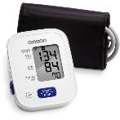

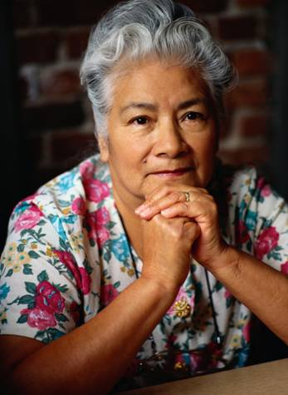
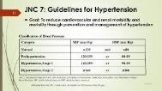
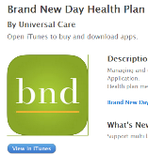



Brand New Day Health Plan
Healthy Heart & CHF
Special Needs Plan
Stratify Risk:
Criteria Card
HRA Score
LACE Score
Obtain MR’s
CHF/CV Hx, LPE, Assessment,
V/S, Labs, Tests, Medication Review/Reconcile, Capture HEDIS, Stars, Educate
T
CHF High Risk
Home Nurse Visit
Coordination
with other
Programs &
Benefits
Monitoring & Support
Multilingual
Eligible Members Receive Their Own BP Cuff
24 Hour Nurse
Advice Line
888) 687-7321
Tele Doc 2017
BND Member App
Clinical Guidelines
Health
Education
Community
Resources
Health Coach Supports Member, CG, PCP & IPA. Develops ICP,
Addresses 7 Fundamentals
of Chronic Care.

Slide 26
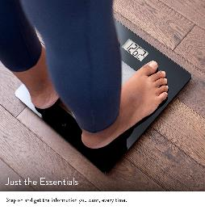
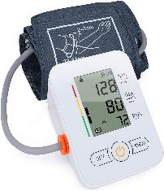
Assistive devices available
BP monitors for those needing frequent monitoring at home
Weight scales for those with CHF or other conditions such as ESRD where fluid overload can indicate need for intervention

Slide 27
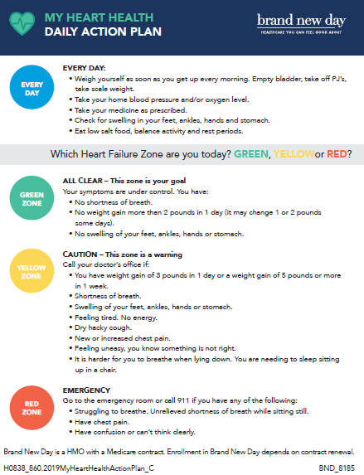
Notes:
27

Slide 28
DSNP Plans
DSNP plans are for those with both Medicare and Medicaid eligibility.
This population is considered at higher risk because of the low-income requirements of those qualifying for Medicaid services.
CMS recognizes that people of lower income levels have had poorer access to health care, and fewer opportunities to improve health
There is no diagnosis related requirements for these members.

Slide 29

Dementia CSNP Plan

Slide 30
The Brand New Day Dementia Program
The Bridges product began in 2014 and serves both Medicare-only and dual-eligible members.
The Bridges product includes two benefit plans.
  Bridges Care is perfect for individuals with Medicare-only coverage (drug savings)
  Bridges Choice is perfect for individuals with dual coverage

Slide 31
The Bridges programs support the following aspects of care:
Community physicians with expertise in caring for the elderly, oversee the Geriatric Medical Home
Members have unlimited access to a Geriatrician, a Neurologist, and other specialists as needed with no copayment
A “Bridges Nurse Champion” (registered nurse with dementia expertise) oversees the Care Management and Support Programs

Slide 32
Each member is assigned a “Health Coach” whose aim is to match care desired to care given
The “Health Coach” works with the member, family, caregiver, and POA to coordinate care not only with the PCP but the healthcare system
The Bridges health coaches provide both face to face and telephonic care.
Through frequent contact with the member and their support system, the health coach works to minimize stress on the member as well as the family
Members are triaged based on their acuity, with our most acute members requiring weekly if not more than once a week visit
Goals of care discussions with the member, family, and care network are carried out by the Health Coach to help manage the Last Year of Life with Excellence

Slide 33
Support for Family & Caregivers
Brand New Day Bridges programs are committed to supporting the member’s Family / Caregivers to prevent exhaustion and burnout through providing the following:
      Free cell phones for members and Family / Caregivers with Low Income
Free Personal Emergency Response System (PERS)

Slide 34
In Home Supportive Services
    Assistance in applying for IHSS
    State Medi-Cal Program that pays the person you select (relative, friend, or other caregiver) for services rendered based on State qualifications.

Slide 35
IHSS (cont’d)
    State may determine to pay for someone to help with bathing, toileting, housekeeping, shopping, meal preparations, etc.
    You hire the person, and the State pays the person.
    BND has partnered with a vendor that can assist members in the application process.

Slide 36
Other Support
    Minor home modifications to prevent falling
    In-home Nurse as needed for wound care, injections, and other LVN services
    Tools to help identify good nursing homes if that becomes necessary

Slide 37
More Support
    Preventive Care Guidelines
    Full medical work-ups so as to ensure other health issues are prevented or detected and treated early
    Materials and Tools to help the Family / Caregiver

Slide 38
Referrals to Complex Case Mgt.
    Referrals to Programs as needed
  Diabetes Care Management
  Major Depression Management
  COPD Care Management
  CHF Care Management
  Palliative Care Management
  Incontinence Training & Care Management
  Chronic Kidney Disease (CKD) Care Management

Slide 39
Pharmacy Support Services
Medication Therapy Mgt.
Medication Adherence Support
Medication Safety
As part of our ICT meetings, a Pharmacist with a sub-specialty in Geriatric Pharmacology reviews cases to reduce polypharmacy

Slide 40
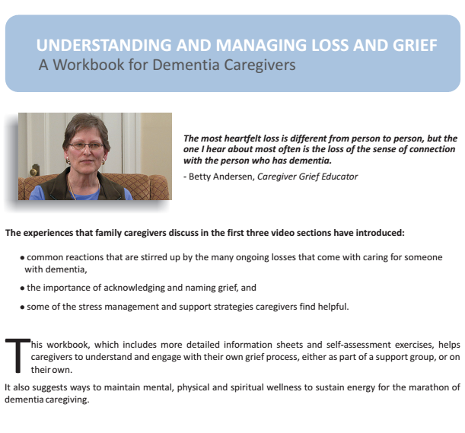
Workbook for Dementia Caregivers

Slide 41
Caregiver Stress Check
10 symptoms of caregiver stress
Denial about the disease and its effect on the person who has been diagnosed.
I know Mom is going to get better.
Anger at the person with Alzheimer's, anger that no cure exists or anger that people don't understand what's happening.
If he asks me that one more time I'll scream!
Social withdrawal from friends and activities that once brought pleasure.
I don't care about getting together with the neighbors anymore.

Slide 42
Anxiety about the future.
What happens when he needs more care than I can provide?
Depression that begins to break your spirit and affects your ability to cope.
I don't care anymore.
Exhaustion that makes it nearly impossible to complete necessary daily tasks.
I'm too tired for this.
Sleeplessness caused by a never-ending list of concerns.
What if she wanders out of the house or falls and hurts herself?

Slide 43
Irritability that leads to moodiness and triggers negative responses and actions.
Leave me alone!
Lack of concentration that makes it difficult to perform familiar tasks.
I was so busy, I forgot we had an appointment.
Health problems that begin to take a mental and physical toll.
I can't remember the last time I felt good.

Slide 44

“This is Me,” - Booklet

Slide 45
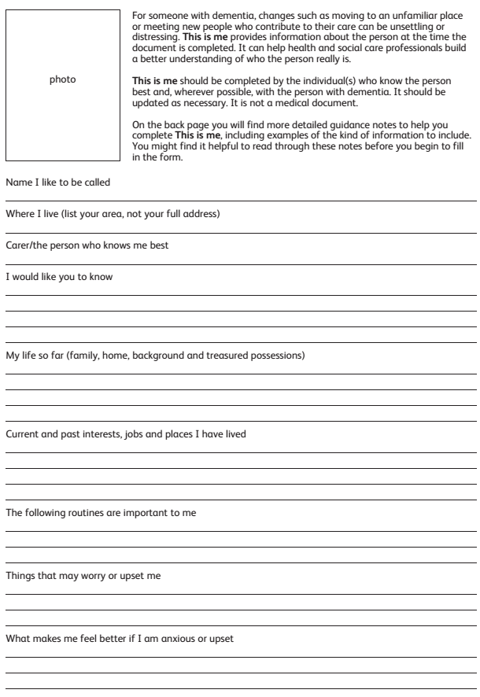

Slide 46


Slide 47
I-SNP and IE-SNP
Institutional and Institutional Equivalent Special Needs Plans
  For members living in skilled nursing facilities, assisted living communities, small unit-board and cares, as well as the home bound individuals that require assistance in activities of daily living

Slide 48
Mobile Medicine and Nursing
The vision of this program is to change the focus and locus of care from the hospital, ER, and clinic setting to wherever the member considers home.
This is done by partnering with physicians, caregivers, ancillary services, and our nursing staff that bring care to the member rather than the other way around.
Through meaningful visits with our membership, and connecting with their family and care network, we can match care desired to care given

Slide 49
Mobile Primary Care
All medical groups in this program visit the members in their desired setting; not in a traditional doctor’s office or clinic.
PCP’s tend to visit their members on a monthly basis due to high risk and added co-morbidities of these population
When appropriate/available, mobile specialists or tele-medicine specialty can be used; again with the purpose of decreasing burden on the member and their care network

Slide 50
Mobile Nursing Care
Much like our PCP’s, the Health Coaches in this program focus on face-to-face in-home care.
Through close collaboration with our PCP network, our Health Coaches work to keep our members out of the hospital and in the comfort of their home
In addition to care coordination services, our health coaches will provide on site clinical care in conjunction with the PCP, Home Health, and/or our FIN department
Members are triaged based on their acuity, with our most acute members requiring weekly if not more than once a week visit
Goals of care discussions with the member, family, and care network are carried out by the Health Coach to help manage the Last Year of Life with Excellence

Slide 51
SNF Diversion Program
When a change of condition arises, our PCP’s and Health Coaches triage the situation for a potential SNF diversion
Many of our mobile PCP’s also round at skilled nursing facilities and can continue to monitor our membership if a higher level of care is needed

Slide 52
COPD & Asthma Care- not yet a CSNP plan but is one of our Care Management Programs.

Slide 53
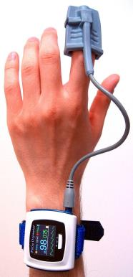
PULSE OXIMETRY
BRAND NEW DAY PROVIDES ITS COPD MEMBERS WITH PULSE OXIMETERS, A NON-INVASIVE TOOL FOR MEASURING THE OXYGEN LEVEL IN THE BLOOD. NORMAL IS BETWEEN 95-100; THE PULSE OXIMETER PROVIDES OUR MEMBERS WITH TANGIBLE “CONTROL” OVER THE DISEASE

Slide 54
THE PROGRAM IS GOLD!
The Brand New Day COPD Program was developed using the evidence-based Global Initiative for Chronic Obstructive Lung Disease (GOLD) strategy to create interventions based on COPD severity of illness:
Stage 0: at risk
Stage 1: mild
Stage 2: moderate
Stage 3: severe
Stage 4: very severe

Slide 55
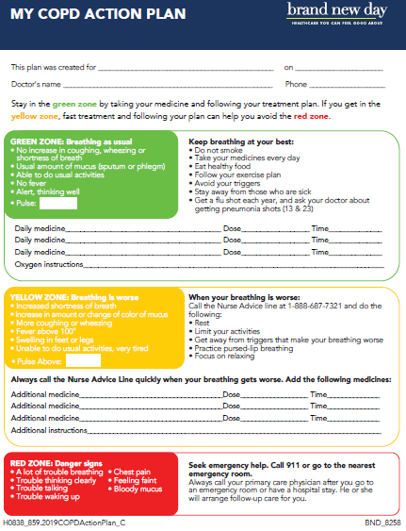

Slide 56
COPD & Asthma Challenge
People with COPD are frequent users of the healthcare system with over 80% having a hospital admission and 60% an emergency room visit per annum.
Reoccurrence
High Risk
Pareto Principle
Avoidable Costs
26%
30%
50%
55%
  26% of COPD patients admitted to the hospital will be readmitted within the next 12 months. CMS all cause readmissions will include COPD in 2015.
  20-30% of COPD patients are classified as “very severe” and are at the highest risk for admissions/readmissions
  50% of all costs incurred by COPD patients will be incurred by just 10% of the population.
  According to the Healthcare Incentives Improvement Institute, over 55% of the costs to treat COPD result from complications such as ER visits and hospitalizations that could be avoided through better management of the condition

Slide 57
Transition of Care

Slide 58
The Care Transitions Intervention:
Designed to encourage older patients and their caregivers to assert a more active role during care transitions.
Nearly 30% of all hospital admissions for people over the age of 65 are directly attributable to medication non-adherence.

Slide 59

The Four Pillars
Medication Self-Management
Patient Centered Health Record (PHR)
Primary Care Provider/Specialist Follow-Up
Knowledge of Red Flags

Slide 60
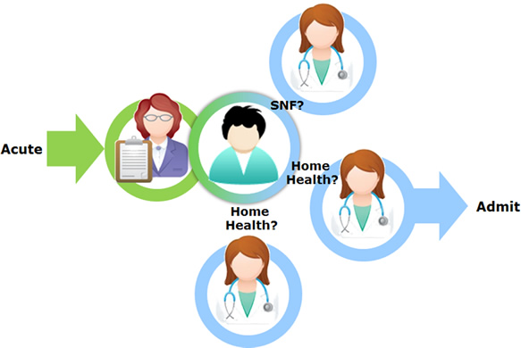
BND Transition of care includes 5 episodes of intervention:
TOC #1 : Hospital/Facility Visit or Call
TOC #2 : Home Visit (telephonic if member declines F2F)
TOC #3 : Follow-up call 7 days after TOC #2 at times
accompany member to doctor’s
appts
TOC #4 : Follow-up call 7 days after TOC #3
TOC #5 : Follow-up call 7 days after TOC #4
*At this point the TOC process is considered complete and only routine
follow-ups are required, as indicated

Slide 61
Key Elements of Intervention
“Transition Coach” (Nurse, Health Coach, or Behavioral Health Care Manager)
  Prepares patient for what to expect and to speak up
  Provides tools (Personal Health Record)
Follows patient to nursing facility or to the home
  Reconciles pre- and post-hospital medications
  Practices or “role-plays” next encounter or visit
Phone calls 2, 7 and 14 days after discharge
  Single point of contact; reinforce, ensure follow up
Intervention Activities
  Hospital Visit
  Home Visit
  2-Day Follow-Up Call
  7-Day Follow-Up Call
  14-Day Follow-up Call

Slide 62
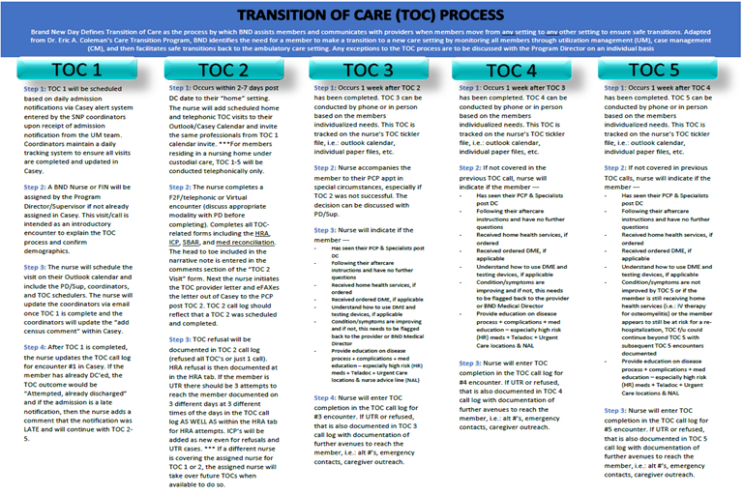

Slide 63
Pharmacy Services

Slide 64
http://www.bndhmo.com/
Select “Members”
Select “Covered Medication List”
The Formulary
  List of medications covered by BND
  Restrictions: PA, ST, QL
    Prior Authorization Criteria
    Step Therapy
    Quantity Limit
  Copay Information
  Updated every month

Slide 65
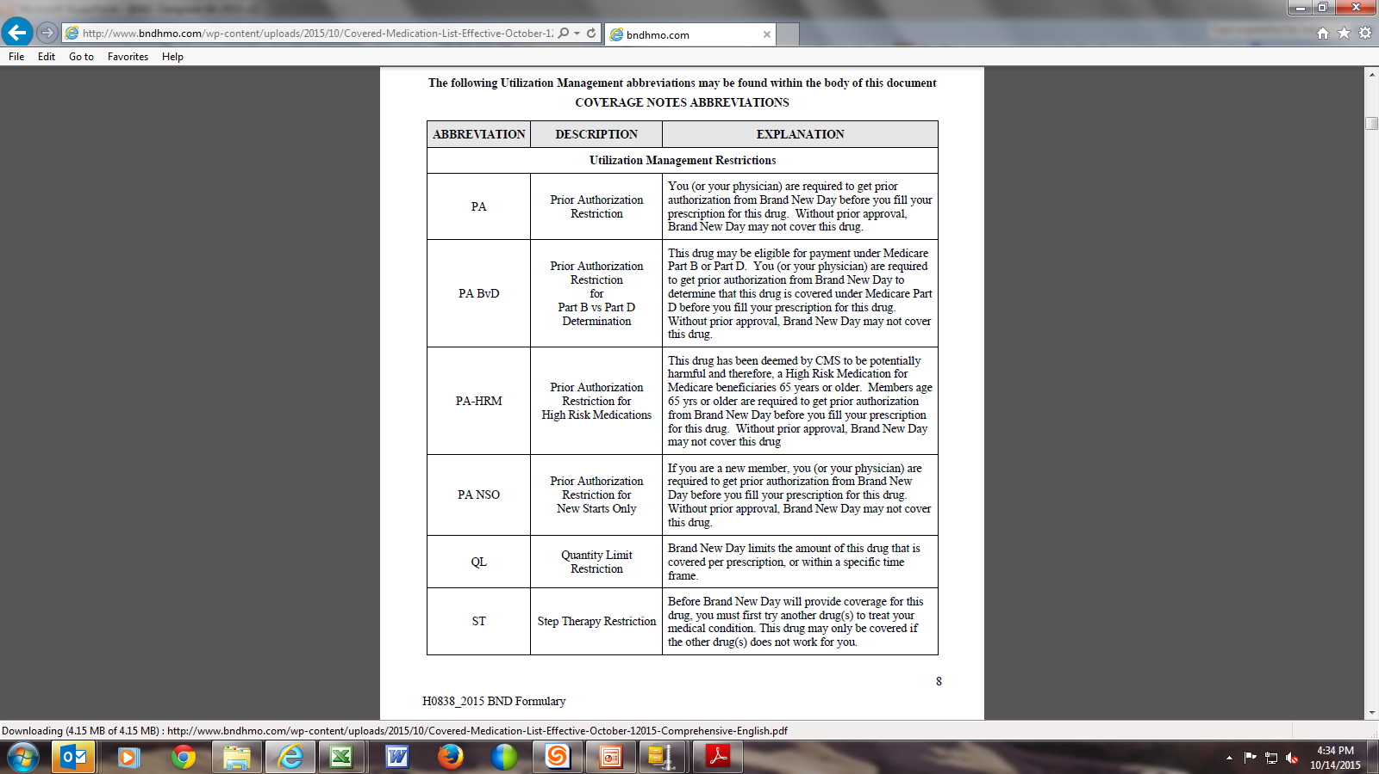
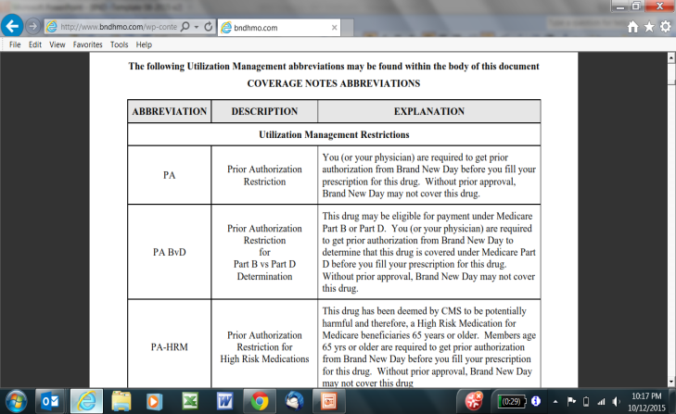
The Formulary - October 2015 Abbreviations, page 8

Slide 66
NonFormulary Medications
NonFormulary Medications can be requested via Medication Request Form (MRF)/Coverage Determination Form
Please fax to MedImpact using number printed on form
  858-790-7100

Slide 67
Helping Members with Medication Issues
Member needs medications transferred from one pharmacy to another
  Please obtain list of medications, then call pharmacy that member wants medications transferred to
  Please have member on line with pharmacy to give permission

Slide 68
Helping Members with Medication Issues
Member cannot go to pharmacy and pick up medications because member is bed bound/and or lacks transportation
  Please contact one of BND’s preferred pharmacies (delivery service)
  Help member apply for transportation benefits
    Members or Providers can call CareCar direct at 1-844-743-4344 or the Brand New Day transportation line at 1-866-255-4795 ext 2047.
  Request help from Field Intervention Nurse (FIN)

Slide 69
Helping Members with Medication Issues - Vacation
If member is going on vacation and needs one month of medication in advance, please call member’s pharmacy and request.
Member’s pharmacy will contact Pharmacy Benefit Manager (PBM) to assist.
Allowed one time per year for chronic medications with refills

Slide 70
Helping Members w/ Med Issues - Representatives
If member is unable to care for him/herself, member’s prescriber or Authorized Other Representative (Power of Attorney) may request medication on member’s behalf
Representatives designated by the Plan must have CMS form 1696 filed with the Plan

Slide 71
Helping Members with Medication Issues
Member cannot afford medications:
  Please help member explore whether or not member is eligible for MediCare Extra help
  Please help member explore whether or not member is eligible for MediCal
  BND has partnered with a vendor that can assist members in the application process for Medicare Extra help.
71

Slide 72
Helping Members with Medication Issues
If MediCare member cannot afford medication copays, please help member apply for Extra Help from MediCare
https://www.ssa.gov/medicare/prescriptionhelp/
72

Slide 73
Mail Order Pharmacy
MedImpact Direct for mail order.
To order by phone, call (855) 873-8739.
To order via internet, go to https://www.medimpactdirect.com/
Or
Postal Prescription Services PPS
To order by phone, call 1-800-552-6694
To order via internet, go to www.ppsrx.com
Member will need to send payment via check, money order or credit card
73

Slide 74
Medication Adherence –
Chronic Medications
Chronic Medications
  Blood Pressure Medications
  Cholesterol Medications
  Diabetes Medications
  Psych Medications
Brand New Day monitors adherence to these medications and then reaches out to both members and providers in order to intervene on any barriers to adherence
74

Slide 75
Member Reimbursement Form
Allows member to receive a coverage determination for direct member reimbursement if a member has to pay out of pocket for a medication while eligible for insurance
Member is not required to use form
Turn around time is 14 days
All information on form is required for reimbursement
A copy of the member reimbursement form is provided in your packet
75

Slide 76
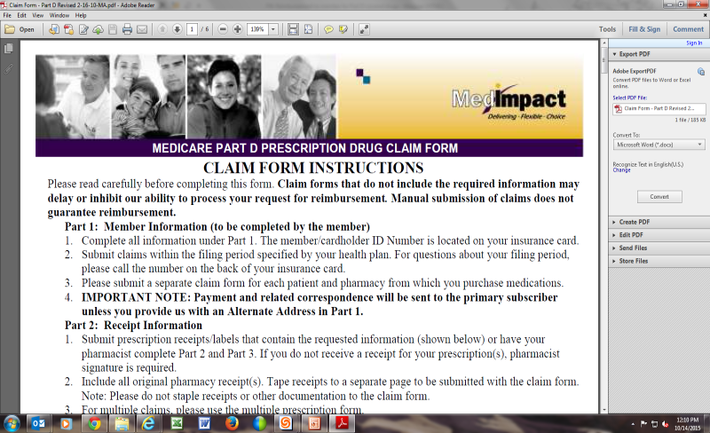
Member Reimbursement Form
76

Slide 77
Harmony and Hope SNP Plans
These are Brand New Day’s Behavioral Health CSNP Plans.
These are for individuals with Severe or Persistent Mental Illnesses, and we refer to theses plans as our SPMI Plans.
Members must have one of the following diagnoses:
F20-F29: Schizophrenia, schizotypal, delusional, and other non-mood psychotic disorders
F30-F36: Mood [affective] disorders – Bipolar Disorders, Major Depressive Disorders
F20: Paranoid Disorders
Brand New Day has been cited by CMS to have one of the best Behavioral Health Plans in the country.

Slide 78
SPMI Plans Model Of Care
BND utilizes a holistic approach to determine a member’s physical, psychological, spiritual, and social needs.
      Medical and Behavioral health needs are based on social determinants of each member.
      The BH Care Managers (BHCM) work closely with Medical add-on nurses to provide hands on care, support, guidance, education, and act as a liaison between the member’s PCP, PTP (psychiatrist), and specialty physicians to maximize health outcomes and prevent unnecessary hospitalizations.
      Our Main Focus is on preventative care.

Slide 79
SPMI Plans Model Of Care
Initial intakes for newly enrolled members are completed by an LCSW, PCP and PTP. During the intake, risk factors are identified, and interventions are implemented (i.e., housing problem or poor medication adherence or substance use issues).
BHCM’s closely monitor for medication adherence, PCP and PTP visits, as well as member’s substance use. This helps with preventing decompensation and unnecessary hospitalizations.

Slide 80
The wellness centers
The Wellness Centers are designed like partial hospitalization programs and operate between 8:30am to 5pm. BH care managers are available to members. Groups and activities are provided by staff daily (i.e., Coping Skills, Symptom Management, Daily Living Skills).
A full time LCSW oversees the day-to-day operations of the wellness center and provides supervision to the BHCM. The LCSW provides ongoing treatment and individual psychotherapy to members based on needs.
The weekly treatment team is very interactive. All members who are being discussed are given opportunity to participate if interested. Recommendations from PCP, PTP’s and/or other specialists are gathered by behavioral health team or Medical add-on team for consideration. Recommendations are discussed with members and documented in members’ ICT record.

Slide 81

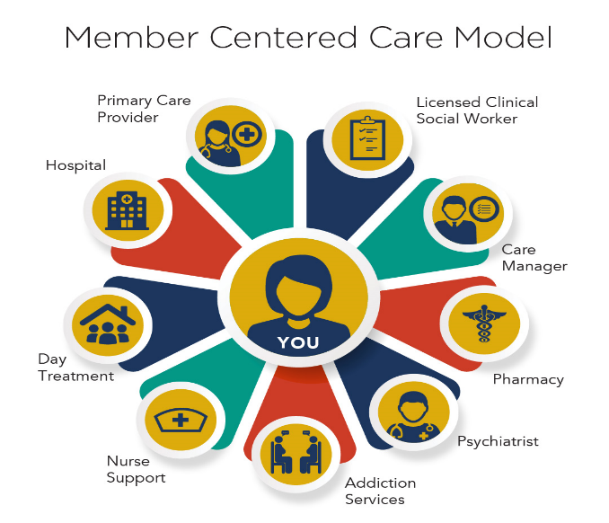



Member Centered Care Model

Slide 82
Medical Risk Criteria
Members are also evaluated for their medical risk level. High risk, mover and low risk. High risk includes two categories; stable and unstable.
  High Risk Members are deemed by Artificial Intelligence (AI) to experience adverse event related to their medical comorbidities. These members are assigned to a
  Medical Add-on nurse.
    Stable - Readmission is not likely within the next 6 months.
    Unstable - Members are likely to be readmitted within the next 6 months.

Slide 83
Medical Risk Criteria cont.
Mover- Members that according to AI may be low risk of experiencing adverse event related to their medical comorbidities that are not managing their chronic diagnosis well as evidenced by having medical risk factors that includes but not limited to polypharmacy, no visit to their PCP in the past year, HbA1C > 8, LDL >=160 and Chronic Condition without prescription.
Low Risk- Members that according to AI are at low risk for of experiencing adverse event related to their medical comorbidities that manages their chronic diagnosis well as evidence by not having any medical risk factors.

Slide 84
Transitions of care
BHCM & Medical add-on nurses are responsible to follow up with members post ED visit, provide follow up with PCP or PTP appointments and medications.
They will address housing needs, help with placement, provides all DMEs, arrange for nurse follow up or care if needed.
All social determinant needs will be addressed, such as applying for IHSS, meals on wheels or transportation.
    BH Care Manager is notified by UM Dept of inpatient hospitalization.
The UM Nurse communicates with the hospital UM Dept, Social Worker and medical director about member’s needs
BH care manager works with the member to implement safe discharge plan. BND Medical Director & psychiatrist oversee the course of hospitalization and make sure member is getting proper care.

Slide 85
Transitions of care
If member requires a higher level of care, BND makes all arrangements which include contracted facilities, assisted living facilities, Board & Cares or sober living.
Due to all the coordinated efforts our length of stay is usually brief, and we do not overutilize the limited hospital beds.
Members are encouraged to be transported to the Wellness Centers post discharge in order to provide them prescriptions and go over the D/C instructions.
Follow-up appointments for psych or medical are made.
DME equipment are in place if needed.
BHCM’s make sure members have support to provide food and care and that the living situation is appropriate for members level of care.

Slide 86
Transitions of care
Members are encouraged to be transported to the Wellness Centers post discharge in order to provide them prescriptions and go over the D/C instructions.
Follow-up appointments for psych or medical are made.
DME equipment are in place if needed.
BHCM’s make sure members have support to provide food and care and that the living situation is appropriate for members level of care.

Slide 87
Substance Use Disorder Services
Appropriateness and willingness for sobriety is evaluated by LCSW.
Use the least restrictive environment based on individual needs.
Ongoing motivational interviewing by BH care manager.
Medication Assisted Treatment (MAT)
Referral to contracted detox and residential Rehab center if required.
Assisting with sober living placement upon discharge.
Referral to community addiction support groups, monitor attendance and provide positive feedback.
Ongoing random urine test.
Referral to individual Psychotherapy by Addiction Specialist.

Slide 88
Referral for Substance Use Treatment
BH UM Dept manages all the referrals for substance use disorder treatment.
Every request is evaluated by a licensed clinician and an appropriate referral is made.
Request can be made by members, treating physician or treating team members.
Some members are identified during ICT meetings.
BH UM Nurse identifies appropriate provider and authorizes services.

Slide 89
Outpatient Psychiatric Services
Outpatient psychiatric services are now available through our Behavioral Health department to all non-SPMI members who need psychiatric care or Substance use treatment.
All referrals will be evaluated by a licensed clinician and appropriate referrals will be made.

Slide 90
SAC-Semi Acute Care
Transitions

Slide 91
What is Semi Acute Care?
Semi Acute Care (SAC) is the use of a SNF in lieu of a hospitalization.
Diversions to a SNF can be arranged from a clinic, ER, or even a member’s home.
If the member is experiencing a change in condition that requires a higher level of care (e.g. UTI, cellulitis, pneumonia) they may be appropriate for SAC.

Slide 92
Exclusion Criteria
If member has a witnessed fall to their head, a fall with a fracture, or chest pain
Member placed on 5150 for DTS or DTO must be admitted to acute care inpatient psych hospital.
If a member placed on 5150 for GD, placing in SAC can be discussed with treating psychiatrist as an alternative
If the member is displaying any aggressive behavior.
Members with current substance abuse issues need to be evaluated for detox or drug rehab programs.

Slide 93
What facilities do we utilize?
We utilize SNF’s across our service network
We have community partners that work directly with our SNF UM team to assist in placement and management of these members

Slide 94
For help with SAC admissions, call Brand New Day UM Department at 866-255-4795 and follow prompts for UM Department

Slide 95
SNP Compliance Requirements
HRA’s- Health Risk Assessments- must be completed within 90 days of enrollment, after a Transition of care, and at least annually.
ICP’s-Interdisciplinary Care Plans- must be completed for each HRA, and at least annually
ICT- Interdisciplinary Care Team- reviews must be completed at least annually on all SNP members.
These requirements are the responsibility of the Health Plan, so Brand New Day does not give this to any of it’s Delegated Providers to complete.
Brand New Day uses an electronic Case Management program to document these, so reporting and tracking can occur

Slide 96
The End

