Slide 1

Cultural Competency & Sensitivity
Training

Slide 2
Course Content
Terminology
Culture
Elements of Culture
Factors Influencing Culture
Diverse Population
Cultural Competence
Four Components of Cultural Competence
Factors of Cultural Incompetency
Linguistic Barriers
Language Preference
Language Services
Importance of Culture Sensitivity
Prospect Values

Slide 3
Terminology
Definitions:
Race: any of the different varieties or populations of human beings distinguished by physical traits such as hair color and texture, eye color, skin color or body shape.
Ethnic: a group having a common cultural heritage or nationality, as distinguished by customs, language, common history, etc.
Culture: the ideas, customs, skills, arts, etc. of a people or group, that are transferred, communicated, or passed along, as in or to succeeding generation
Competence – The quality of being adequately or well qualified physically and intellectually
Linguistics – the scientific study of language

Slide 4
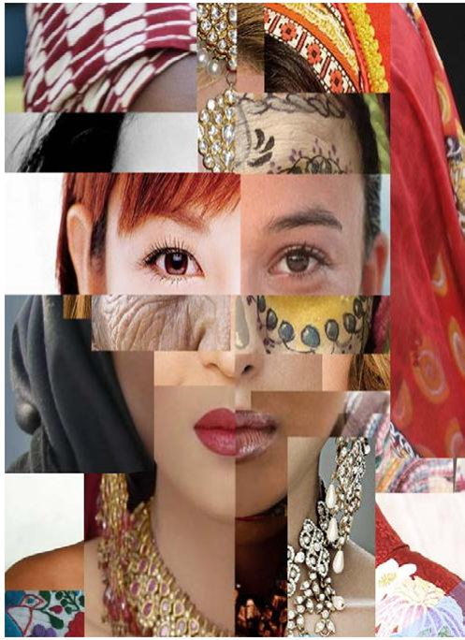
Culture
An integrated pattern of human behavior that includes:
Thoughts
Communications
Languages
Practices, beliefs, values, customs, courtesies and rituals
Manners of interacting
Relationships and expected behaviors of a racial, ethnic, religious, social or political group
The ability to transmit the above to succeeding generations is dynamic in nature.

Slide 5

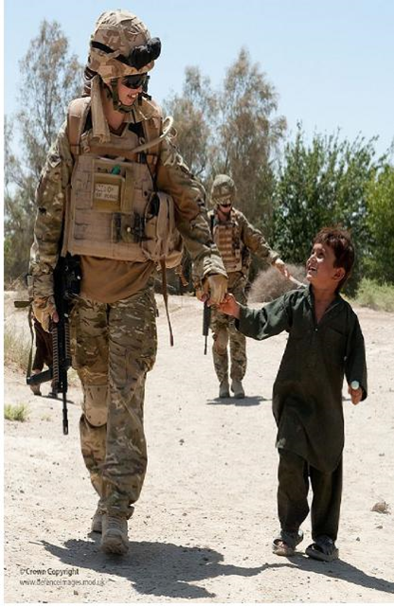
Elements of Culture
Age
Cognitive ability or limitations
Country of origin
Education level attained
Environment and surroundings
Family and household composition
Gender identity
Generation
Military affiliation
Occupational groups
The following perceptions of:
    family and community
    health and well-being
    related practices and beliefs
    diet and nutrition
Health practices, including use of traditional healer techniques such as Reiki and acupuncture
Linguistic characteristics, including language(s) spoken, written, or signed; dialects or regional variants; literacy levels and other related communication needs

Slide 6
Factors Influencing Culture
Migration
Gender
Ethnicity
Age
Factors Influencing Culture
National Origin
National Origin
Socioeconomic Status
Geographic Location
Migration
Sexual Orientation
Gender Identity

Slide 7

Cultural Competence
What is cultural competence?
The state of being capable of functioning effectively in the context of cultural differences
A set of congruent skills, attitudes, polices and structures, which come together to enable a system or agency to work effectively in the context of cultural differences
Attention to the dynamics of difference
Continuing self-assessment regarding culture
Acceptance and respect for differences
Ongoing development of cultural knowledge and resources
Dynamic and flexible application of service models to meet the needs of minority populations

Slide 8
Four Components of Cultural Competence
Awareness of one’s own cultural worldview
Knowledge of different cultural practices and worldviews
Attitude towards cultural differences
Cross-cultural skills

Slide 9
Factors contributing to Cultural Incompetency:
Disparity
Privilege
Prejudice
Stereotype
Bias
Discrimination
Ageism
Sexism
Racism

Slide 10
Factors of Cultural Incompetency
Disparity is the state of being unequal
Privilege is a special right, advantage, or immunity granted or available only to a
particular person or group of people.
Prejudice is preconceived opinion that is not based on reason or actual experience.
Stereotype is a widely held but fixed and oversimplified image or idea of a
particular type of person or thing.
Bias is an inclination of temperament or outlook to present or hold a partial
perspective, often accompanied by a refusal to even consider the possible merits of
alternative points of view.

Slide 11
Continued: Factors of Cultural Incompetency
Discrimination is an action that denies social participation or human rights to
categories of people based on their actual or perceived membership in a certain group or social
category.
Ageism is stereotyping and discriminating against individuals or groups on the basis of their age.
Sexism is a prejudice or discrimination based on a person’s sex or gender
Racism consists of both prejudice and discrimination based on social perceptions of
biological differences between people.

Slide 12
Linguistic Barriers
Research indicates that LEP members may face linguistic barriers when accessing health care services, such as:
Risk and predisposition to disease
Disease prevalence, health status and diagnosis
Differences in quality of health care delivery
Poor health outcomes

Slide 13
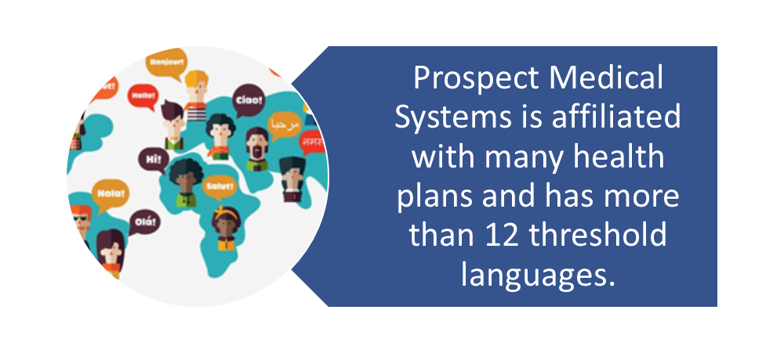
Language Preference
LEP Members can be identified by referring to IDX Language Preference Indicator.
Offer interpreter services at no cost to the member.

Slide 14
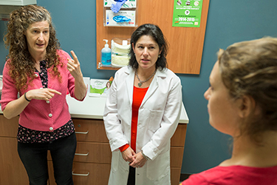
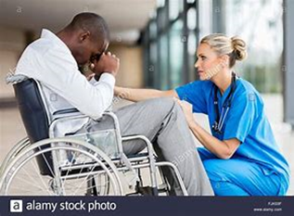

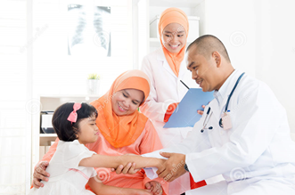
Importance of Cultural Sensitivity
Culture sensitivity training is so important to Prospect Medical Systems because it provides a better understanding of respecting other cultures. Prospect employees and staff are better able to interact and communicate with colleagues, providers, members and patients providing higher Quality Care!

Slide 15

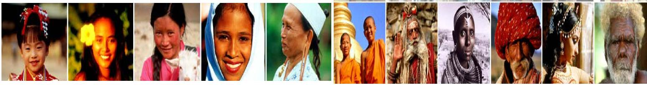
Diverse Member Population
Prospect Medical membership is very diverse. Members who do not speak English as their primary language and have limited ability to speak, write, or understand English can be limited English proficient or “LEP”.
Members who are LEP may be entitled language assistance with respect to a particular type or service, benefit, or encounter.
Prospect Medical provides:
face-to-face oral interpretation
sign language interpretation for medical appointments
telephonic interpretation
translated written communication
Alternate format of materials – upon request partnered with Health Plan

Slide 16
Language Services
Prospect Medical Systems members have the right to certain language services:
Telephonic Interpretation: Language Line -1-800-874-9426.
Requests for translated materials contact Customer Service
Face to Face Interpretation requires prior authorization
Hearing impaired assistance dial 711 for California Relay Service
Requests for alternative formatted materials contact Customer Service
Customer Service contact numbers are 1-714-796-5900 or toll-free number 1-800-708-3230

Slide 17
Knowledge Check
1. Culture is defined as:
    Thoughts
    Communications and Languages
    Relationships and expected behaviors of racial, ethnic, religious, social or political group
    Practices, beliefs, values, customs and rituals
    All the above
2. All are Cultural Incompetence factors EXECPT:
Prejudice
Bias
Stereotype
Equality
Privilege

Slide 18
Knowledge Check
3. A human being or a population’s race can be distinguished by:
    Common Language
    Shape of eyes
    Physical traits such as hair color and texture, eye color, skin color or body shape
    Place of birth
4. Ethnic is defined as a group having:
Common cultural heritage
Common nationality
Common language
Common history
All the above

Slide 19
Knowledge Check – Confirm your answers!
1. e.) All the above
d.) Equality
3. c.) Physical traits and hair color and texture,
eye color, skin color or body shape
e.) All the above

Slide 20
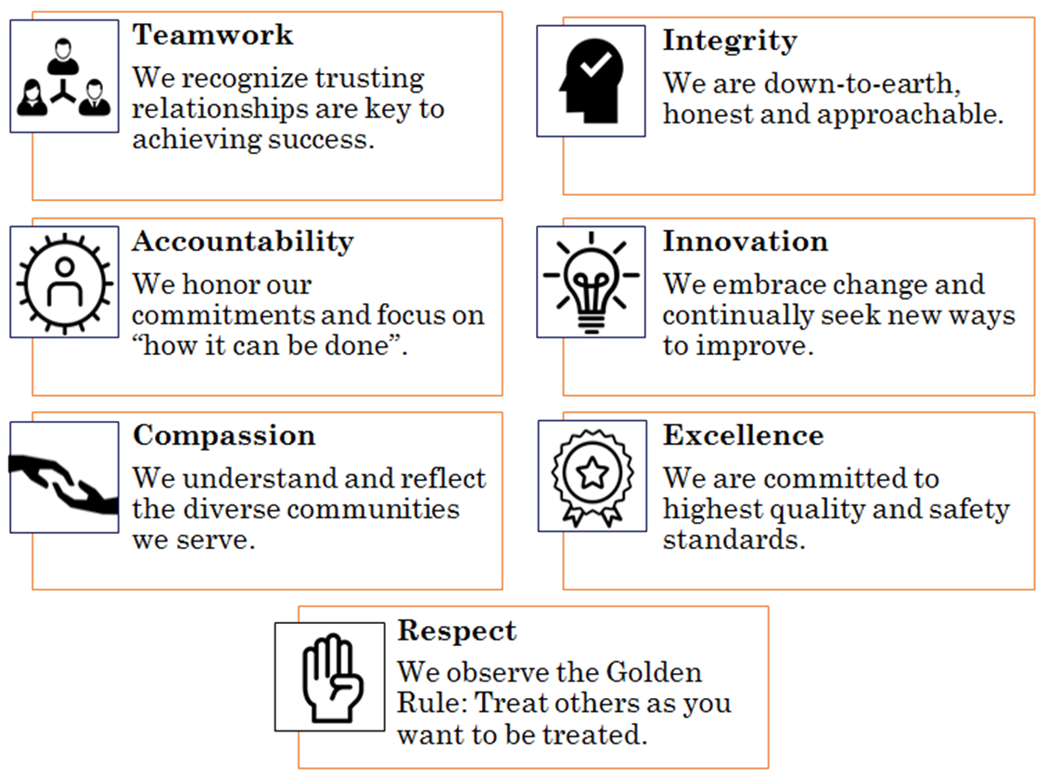
Prospect Values

Slide 21
Authorities
Title 9, Code of Federal Regulation, Section 1810.410 (f) (3)
Title 45, Code of Federal Regulations, Section 84.52
Title 42, Code of Federal Regulations, Section 422.112
Centers for Medicare & Medicaid Services (CMS)
Office of Minority Health, Nationals Standards on Culturally and Linguistically Appropriate Services (CLAS)
Medicare Managed Care Manual, Chapter 4

Slide 22


