Slide 1

Medi-Cal for Kids & Teens
Provider Training
Medi-Cal for May 2024
Kids and Teens

Slide 2
Today’s Training
» Goals & Purpose of Today’s Training
» Training Modules
Module 1: What is Medi-Cal for Kids & Teens and How Does it Work?
Module 2: Deep Dive into Behavioral Health Services, California
Children’s Services Program, and Skilled Nursing Services
2

Slide 3
Federal law enacted in 1967 established Early and
Periodic Screening, Diagnostic and Treatment
(EPSDT), which guarantees all medically necessary
services to children and youth under age 21
enrolled in Medi-Cal. As of 2023, California refers to
EPSDT as
Medi-Cal for Kids & Teens
3

Slide 4
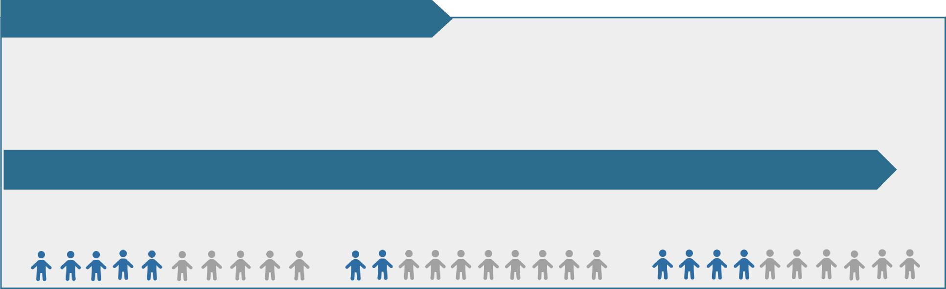
Millions of Children in Medi-Cal Are Not
Receiving Preventative Health Services
In 2019, the California State Auditor released a report highlighting the low rates of children’s preventative health
services in Medi-Cal. A follow-up audit in 2022 underscored that millions of Medi-Cal-enrolled children are still not
receiving preventative services. In response, the Department of Health Care Services (DHCS) committed to developing a
standardized provider training on Medi-Cal for Kids & Teens.
The 2019 California State Audit found:
2.4 million children enrolled in Medi-Cal
did not receive required preventive
services – roughly half of all children
under age 21 in Medi-Cal
Pre-pandemic, California ranked 40th
nationwide for utilization of children’s
preventive services, or 10 percentage points
below the national average
Since the COVID-19 pandemic, California’s preventive services utilization has continued to decline:
1 in 2 children ages 12 – 21 received
at least one annual well-care visit
22% of children under the age of 3
received a developmental screening
Less than half of children at age 13
were fully immunized
4

Slide 5

Goals of Medi-Cal for Kids & Teens
Provider Training
The training aims to strengthen understanding and awareness of Medi-Cal for Kids & Teens among Medi-
Cal managed care plan-enrolled providers and increase access to children’s health services.
 | > California’s managed care plans must ensure that all Medi- Cal licensed providers receive proper education and training regarding Medi-Cal for Kids & Teens at least every two years. > More information on Medi-Cal for Kids & Teens for providers is available in the Information for Medi-Cal Providers resource document.
5

Slide 6


Medi-Cal for Kids & Teens
Training Modules
 | Module 1: What is Medi-Cal for Kids & Teens and How Does it Work?
 | Module 2: Deep Dive into Behavioral Health Services, California Children’s Services Program, and Skilled Nursing Services
6

Slide 7

Module 1 | Module 2
In This Module You Will Learn:
' What is Medi-Cal for Kids & Teens
' What screening, diagnostic services, and treatment services are covered
under Medi-Cal for Kids & Teens
' What the definition of “medical necessity” means for children enrolled in
Medi-Cal
' What limitations can be placed on Medi-Cal for Kids & Teens services
' How you can help support access to required services for your patients
' Your role in informing children and families about Medi-Cal for Kids &
Teens covered services
7

Slide 8

Module 1 | Module 2
What is Medi-Cal for Kids & Teens?
» Requires comprehensive age-
appropriate health care service be
provided to all Medi-Cal enrolled
children and you under age 21
» Requires preventative screening,
diagnostic services, and treatment
services
» Screenings, coverage
requirements, and definition of
medical necessity for children
enrolled in Medi-Cal are more
robust than that for adults’ care
Goal of Medi-Cal for
Kids & Teens
Ensure that children get the
Right Care
at the
Right Time
in the
Right Place
8

Slide 9

Module 1 | Module 2
Medi-Cal for Kids & Teens Services Are
Free for Most Children Under Age 21
» All medically necessary Medi-Cal for Kids & Teens preventative,
screening, diagnostic, and treatment services for children and
you are free for most children and youth under age 21
» Some youth between ages 18 and 20 enrolled in Medi-Cal may
pay a “Share of Cost” for some treatment based on their
income and family size. This is determined at the time of Medi-
Cal eligibility. These youth are “carved out” of Medi-Cal
managed care and receive services through fee-for-service.
9

Slide 10

Module 1 | Module 2
Medi-Cal for Kids & Teens
Periodicity Schedule
' Medi-Cal for Kids & Teens follows the Bright Futures/American
Academy of Pediatrics (BF/AAP) Periodicity Schedule.
' The BF/AAP Periodicity Schedule is a schedule of screenings and
assessments recommended at each well-child visit from infancy through
adolescence.
' The most up to date BF/AAP Periodicity Schedule can be accessed online
here.
10

Slide 11
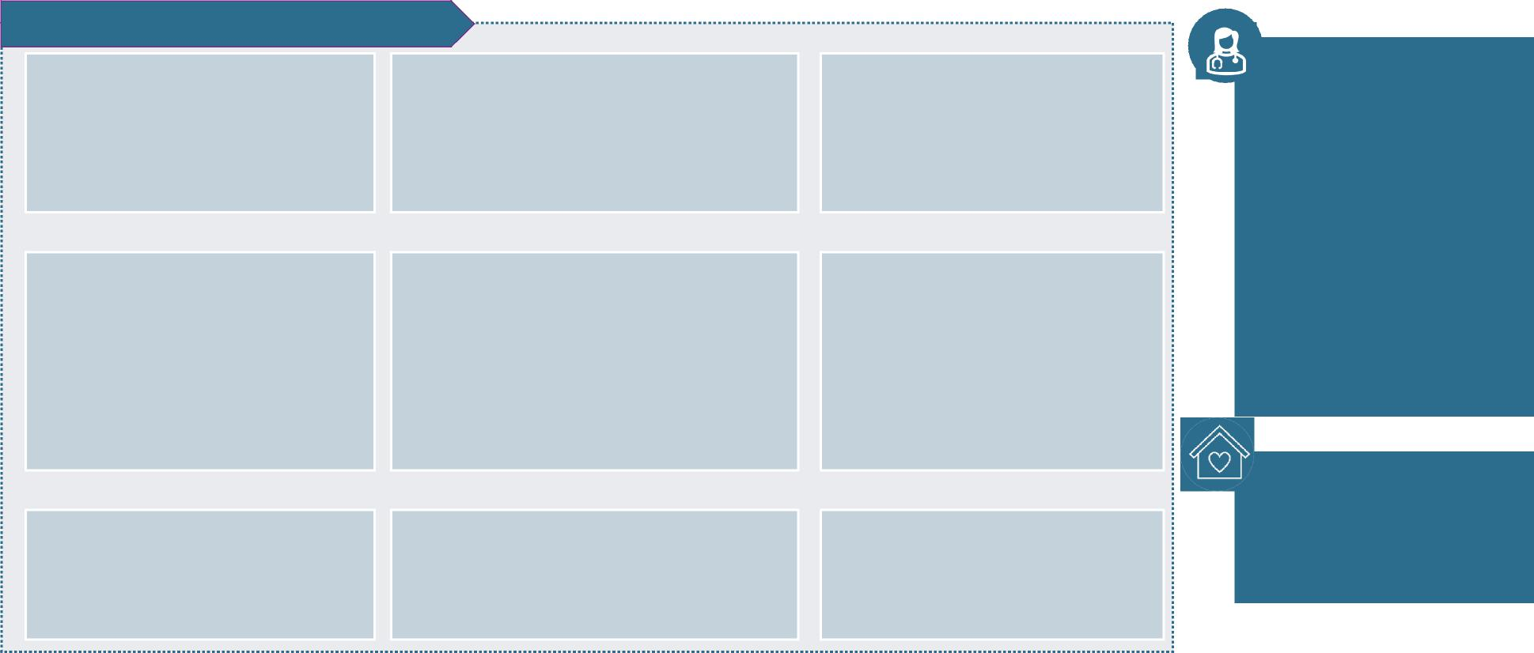
Module 1
Module 2
Medi-Cal for Kids & Teens Periodic Screenings
Medi-Cal for Kids & Teens screening services are designed to identify health and developmental issues as early
as possible.
Reimbursable Screening Services
Behavioral health screening, including depression screening and tobacco, alcohol, or drug use
Any qualified Medi-Cal provider (acting within the scope of their practice) may conduct these screenings.
Screenings may be provided at physician offices and clinics, community health centers, local health departments, or schools
Comprehensive, unclothed physical exam, including nutritional, height/weight, and Body Mass Index assessment
Comprehensive health and developmental history
Age-appropriate immunizations (based on the Bright Futures / American Academy of Pediatrics (BF/AAP) Periodicity Schedule and Advisory Committee on Immunization Practices (ACIP) Recommendations)
Developmental screening for physical and mental health using standardized screening tools
Age-appropriate laboratory tests, including blood lead screening test
Families do not need to request these screenings, and prior authorizations are not permitted
Oral health screenings and referrals to a dentist (beginning by age 1 or eruption of first tooth)
Health education and anticipatory guidance for child and caregiver
Age-appropriate vision and hearing screenings
11

Slide 12
Module 1
Module 2
Medi-Cal for Kids & Teens
Screenings & Services
The following slides outline requirements for a subset of required screenings and services, including screening
tools and billing codes.
Subset of Required Medi-Cal for Kids & Teens Screenings & Services
Blood Lead Screening Services | Vision Screening Services
Developmental Screening Services | Hearing Screening Services
Autism Spectrum Disorder (ASD) Screening Services | Oral Health Screening Services
Depression Screening Services (for adolescents and postpartum individuals) | Adverse Childhood Experiences (ACEs)/Trauma Screening Services
Dyadic Services | Alcohol and Drug Screening, Assessment, Brief Interventions and Referral to Treatment (SABIRT)
12

Slide 13
Module 1
Module 2
Blood Lead Screening Services (1 of 2)
Providers must perform blood lead screening tests at specific intervals and deliver anticipatory guidance to
parents/caregivers that indicates children can be harmed by exposure to lead and are at risk of lead poisoning.
» Anticipatory Guidance. Providers must provide oral or written anticipatory guidance to parents or caregivers
at each well-child visit starting at 6 months until 6 years of age; guidance must include information on:
The harm of lead exposure to children (especially from lead-based paint and its dust) and
The risk of lead poisoning from the time a child begins to crawl until 6 years of age
» Periodicity Schedule. Providers must order or perform blood lead screening tests for children at the
following intervals:
At 12 months and 24 months of age;
In between 12 to 24 months of age if the child has no documented evidence of a blood lead screening test
taken;
In between 24 months to 6 years of age if the child has no documented evidence of a blood lead screening
test taken;
Any time a change in circumstances has put the child at risk; or
If requested by the parent or caregiver
13

Slide 14
Module 1
Module 2
Blood Lead Screening Services (2 of 2)
» Refugee Screening. Providers must follow the CDC Recommendations for Post-Arrival Lead
Screening of Refugees, which states that all refugee children ages 0-16 or adolescents over age 16
with suspected lead exposure should be evaluated with a blood lead screening test
» Billing Codes. The CPT codes available for blood lead screening include:
36415 (venipuncture) 36416 (finger stick) 83655 (lead test) | 99401, 99402, 99403, 99404 (preventive medicine counseling at 15 min intervals)
See California Department of Public Health’s (CDPH) Standard of Care Guidelines on Childhood Lead
Poisoning for California Health Care Providersfor more information
14

Slide 15

Module 1
Module 2
Developmental Screening Services
Providers must deliver developmental screenings at age-appropriate intervals at ages 9 months, 18 months,
and 30 months per BF/AAP Periodicity Schedule, and when medically indicated.
» Overview. The developmental screening includes a comprehensive health and developmental history, including
both physical and mental health development assessments, designed to identify if a child’s motor, language,
cognitive, social, and emotional development are on track and connect to services, if needed
Billing Codes. The CPT code for reimbursement is 96110; screenings can be provided twice a year for children
ages 0 to 5
Screening Tools. Providers must use a standardized screening tool, with approved options including:
- Ages and Stages Questionnaire (ASQ)
- Ages and Stages Questionnaire (ASQ-3)
- Battelle Developmental Inventory Screening Tool (BDI-ST)
- Bayley Infant Neuro-developmental Screen (BINS)
- Brigance Screens-II
- Child Development Inventory (CDI)
- Infant Development
- Parents’ Evaluation of Developmental Status (PEDS)
- Parent’s Evaluation of Developmental Status -
Developmental Milestones (PEDS-DM)
» Referrals to Regional Centers. Providers should refer children to Regional Centers for services and supports that
are needed because of a developmental disability
Supplemental Incentive Payment. Under Proposition 56, Medi-Cal reimburses providers a supplemental
incentive payment of $59.90 for developmental screenings 15

Slide 16

Module 1
Module 2
Autism Spectrum Disorder Screening Services
Providers must perform autism spectrum disorder (ASD) screenings at 18 and 24 months, per the BF/AAP
Periodicity Schedule, and when medically indicated.
> Billing Codes. Providers should use the developmental screening CPT code 96110 but must include the modifier KX
ASD and developmental screenings are reimbursable when performed on the same day at 18 months and when
medically indicated
> Screening Tool. Providers must use a validated screening tool to screen for ASD, such as: MCHAT-R/F (ages 16 to 30
months old); SCQ (ages 4 years old and up); and STAT (ages 24 to 35 months old)
> Services & Referrals. Medi-Cal for Kids & Teens covers all medically necessary behavioral health treatment for
eligible enrollees under 21 years of age regardless of ASD diagnosis
Behavioral health treatment services include applied behavioral analysis (ABA) and a variety of other evidence-
based approaches that prevent or minimize the adverse effects of behaviors that interfere with learning and
social interaction, and promote, and functioning
Providers should refer individuals to either their managed care plan or their local Regional Center to receive
medically necessary behavioral health treatment services
 | Examples of behavioral health treatment services include behavioral interventions, cognitive behavioral intervention, comprehensive behavioral treatment, language training, modeling, natural teaching strategies, parent/guardian training, peer training, pivotal response training, schedules, scripting, self-management, social skills package, and story-based interventions. 16

Slide 17
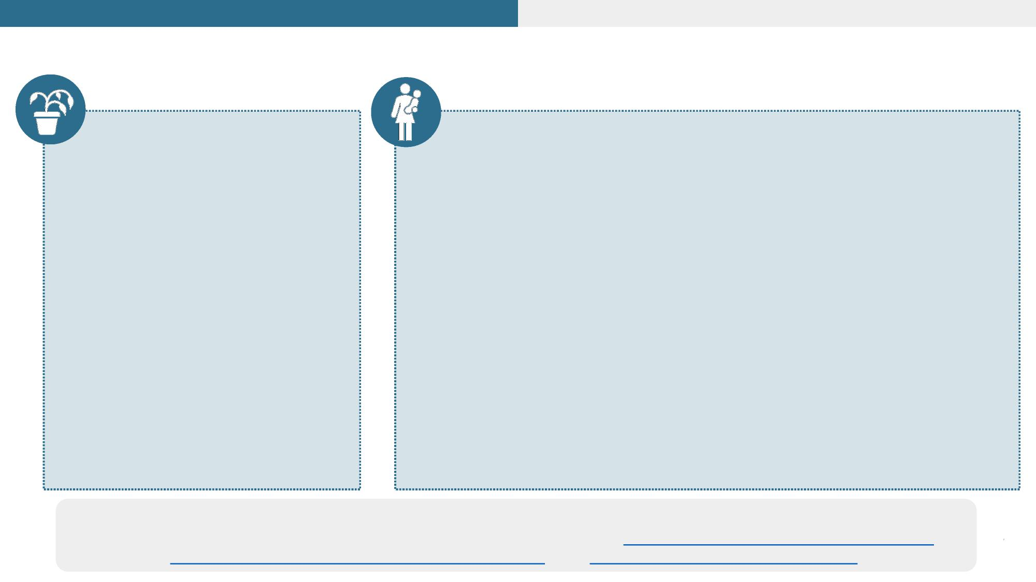
Module 1
Module 2
Depression Screening Services
Depression Screening
» Periodicity Schedule. Providers
must perform depression
screenings on children ages 12
and older at every well-child visit
Postpartum Depression Screening at Infant Visits
» Periodicity Schedule. Providers may perform postpartum
depression screenings for the birthing parent at up to four times
during an infant’s first year of life
BF/AAP Periodicity Schedule recommends this happens during
the well-infant visits at 1, 2, 4, and 6 months of age
Billing Processes. These screenings must be billed to the
infant’s Medi-Cal ID regardless if the birthing parent is enrolled
in Medi-Cal; if the infant’s Medi-Cal eligibility has not been
established during the first two months of life, the screening
may be billed to the birthing parent’s Medi-Cal ID
» Billing Codes. Providers must submit at least one claim with a
diagnosis code if multiple depression screenings are performed for a
single Medi-Cal member with HCPCS codes G8431 and G8510 in a
year.
» Billing Codes. The HCPCS
codes are G8431 (positive
screening with follow-up plan)
and G8510 (negative screening
and no follow-up plan) may not
be submitted more than once a
year per child unless to correct or
ameliorate a condition (see slides
27-29). Apply modifier EP for
EPSDT services.
Screening Tools. Providers must use a validated depression screening tool for children and youth and
pregnant or postpartum individuals, with options including the Patient Health Questionnaire (PHQ-9), 17
Edinburgh Postnatal Depression Scale (EPDS), and Beck Depression Inventory (BDI) Updated May 2024

Slide 18

Module 1
Module 2
Dyadic Services
As of January 2023, Medi-Cal covers dyadic and family therapy services, which include integrated physical and
behavioral health screenings and services for the child and their parent/caregiver or whole family, not just the
child who is the identified patient. Dyadic services involve simultaneous treatment for the child and
parent/caregiver, with studies showing significant improvements in child behavior issues and increases in
positive parent/child attachment.
Dyadic Services for Parent/Caregivers Billing
Codes. Providers may also deliver dyadic caregiver
services at a well child visit in which the caregiver(s) are
present. The U1 modifier is required to designate dyadic
services.
> Brief emotional/behavioral assessment (96127)
> ACE screening (G9919, G9920)
> SABIRT (G0442, H0049, H0050)
> Depression screening (G8431, G8510)
> Health behavior assessments and interventions
(96156, 96167, 96168, 96170 and 96171)
> Psychiatric diagnostic evaluation (90791, 90792)
> Tobacco cessation counseling (99406, 99407)
Dyadic Services for Children ages 0 to 20
Billing Codes. Medi-Cal reimburses a number of
dyadic services for recipients ages 0 to 20 years,
when billed to the child’s Medi-Cal ID. The U1
modifier is required to designate dyadic services.
> Dyadic Behavioral Health (DBH) Well-Child Visits
(H1011)
> Dyadic Comprehensive Community Support
Services (H2015)
> Dyadic Psychoeducational Services (H2027)
> Dyadic Family Training and Counseling for Child
Development (T1027)
 |  | See the Non-Specialty Mental Health Services Manualfor more information on dyadic services billing codes, modifiers, and screenings 18 Updated May 2024

Slide 19

Module 1
Module 2
Vision and Hearing Screening Services
Providers must deliver vision and hearing screening for all children and youth under age 21 per BF/AAP
Periodicity Schedule to identify need for glasses, contacts, hearing aids, cochlear implants, or other concerns.
Vision Screening
» Periodicity Schedule. Providers must conduct vision
screenings at years 3, 4, 5, 6, 8, 10, 12, and 15, with
risk assessments conducted at other ages
» Screening Tools.
Providers may use instrument-based screening
to assess risk at ages 12 and 24 months and at
well child visits at ages 3 through 5 years
Providers may deliver a visual acuity screening
starting at ages 4 and 5 years, as well as in
cooperative 3-year-olds
» Billing Codes. Reimbursement codes include CPT
99173*, 99381 thru 99385 and 99391 thru 99395
*For school-based enrolled Medi-Cal providers only
Hearing Screening
» Periodicity Schedule.
Providers must confirm the initial newborn
screening was completed, verify results, and
follow up as appropriate
After the newborn screening, providers must
conduct hearing screenings at years 4, 8, 10,
13, 16, and 20, with risk assessments
conducted at other ages
» Billing Codes. Reimbursement codes include CPT
92551 (screening test, pure tone, air only) and 92552
(pure tone audiometry [threshold]; air only) with ICD-
10-CM diagnosis codes Z00.121, Z00.129, Z01.10, or
Z01.11 available for hearing screenings
19

Slide 20

Module 1
Module 2
Oral Health Screening & Assessment Services
Providers must perform oral health screening and assessment services and ensure children ages 6 years and
under are referred to a Medi-Cal Dental provider. Primary care providers have an important role in ensuring
oral health care, guidance, and education are provided to children and families.
» Oral Health Screening Schedule.
Primary care providers must conduct an oral health assessment at minimum at the 6, 9, 12, 18, 24, and 30 month
well-child visits, as well as annually starting at age 3 and up or sooner at eruption of first tooth, should that occur
first
On this same schedule, primary care providers must assess whether the child has a dental home. If no dental
home is identified, then providers must refer the child to a Medi-Cal dental provider
» Billing Codes. Reimbursement codes CPT 99381 – 99383 and 99391 – 99393 for oral health risk assessment
» Fluoride Varnish. Once teeth are present, fluoride varnish should be applied to all children every 3 – 6 months through
age 5 in the primary care or dental office based on caries risk
Reimbursement codes HCPCS D1206 and CPT 99188 for fluoride varnish, up to three times in 12-month period
» Fluoride Supplementation. If a child’s primary water source does not contain fluoride, primary care providers must
consider providing fluoride supplementation to children ages 6 months through 16 years of age
 | Dental providers are responsible for providing dental care that goes beyond oral health assessments (such as dental cleanings and tooth extractions). Medi-Cal managed care providers are responsible for providing referrals to a dental provider in the child’s network, which will either be Dental Fee For Services (in most California counties) or Dental 20 Managed Care (in Sacramento and Los Angeles Counties).

Slide 21

Module 1
Module 2
ACEs/Trauma Screening Services
Providers may conduct adverse childhood experiences (ACEs) screenings for all children and youth under age
21. ACEs screenings are not currently included in the BF/AAP Periodicity Schedule but are encouraged through
the California Surgeon General’s ACEs Aware campaign and are reimbursable.
» Recommended Schedule. Providers may conduct ACEs screenings once per year, per child
▪ ACEs “scores” are designated as high risk for toxic stress if a child’s ACEs score is 4 or greater (HCPCS G9919)
or low risk for toxic stress if the ACEs score is between 0 and 3 (HCPCS G9920)
» Screening Tool. Providers must use the validated PEARLS screening toolfor ages 0 – 19 years for ACEs screening
» Provider Training. Providers must complete andattestto having completed the ACEs Aware Trainingin order to
be eligible to receive the incentive payment (see box below)
» Referrals. Providers who conduct ACEs screenings must provide children with appropriate referrals when
necessary for diagnosis and treatment without delay
 |  |  | Supplemental Incentive Payment. Under Proposition 56, Medi-Cal reimburses providers who completed and attested to the ACES Aware training with a supplemental incentive payment of $29.00 for trauma screenings
21

Slide 22
Module 1
Module 2
Alcohol and Drug Screening, Assessment, Brief
Interventions and Referral to Treatment (SABIRT)
Providers must provide SABIRT screening and services to children ages 11 years and older with a potential
substance use disorder (SUD).
» Screening.
Validated screening tools for children/adolescents: Parents, Partner, Past,
and Present (4Ps) and Car, Relax, Alone, Forget, Friends, Trouble (CRAFFT)
Billing Codes. Reimbursement codes HCPCS G0442 for alcohol use
screening and H0049 for drug use screening
If using CRAFFT, which is for alcohol and drug use screening,
providers can bill both G0442 and H0049
» Brief Assessment. If a screening is positive, then providers should assess
whether the disorder is present.
Validated assessment tools: Drug Abuse Screening Test (DAST-20) and
Alcohol Use Disorders Identification Test (AUDIT)
» Brief Interventions & Referral to Treatment. If a brief assessment reveals
alcohol or drug misuse, providers can conduct brief interventions, which can
include alcohol misuse counseling and discussing and agreeing on plans for
follow-up, including referral to other treatment if indicated.
Billing Codes. Reimbursement code HCPCS H0050 for alcohol and/or
drug brief intervention services
» Provider Type. SABIRT services are
reimbursable to physicians, physician
assistants, nurse practitioners, certified
nurse midwives, licensed midwives,
licensed clinical social workers, licensed
professional clinical counselors,
psychologists, and licensed marriage and
family therapists
» Documentation Requirements. The
provider must include in the child’s
medical records:
The service provided (e.g., screen
and brief intervention);
The name of the screening and/or
assessment tool and scores; and
If a referral to an alcohol or SUD
program was made 22

Slide 23

Module 1
Module 2
Initial Health Appointment
Previously called the “Initial Health Assessment (IHA),” the Initial Health Appointment (IHA) is a Medi-Cal
managed care requirement for adults and children to ensure new members receive a comprehensive assessment
by a primary care provider.
» The IHA consists of a history of the member’s physical and behavioral health, identification of risks,
assessment of need for preventive screens or services and health education, and the diagnosis and plan for
treatment of any diseases
» Providers must conduct the IHA within 120 days of a child’s enrollment in a managed care plan (or within
the BF/AAP Periodicity Schedule timeline for children ages 18 months or younger, whichever is sooner)
If the first 120 days of a child’s enrollment in a managed care plan falls within the timing of a child’s
scheduled well-child visit according to the BF/AAP Periodicity Schedule, the child’s well-child visit will
serve as the IHA
IHA cannot be delayed beyond the first 120 days of a child’s initial enrollment in order to coincide
with a scheduled well-child visit according to the BF/AAP Periodicity Schedule that is later than 120
days from enrollment; an earlier, separate IHA will be indicated in this case
» Each managed care plans’ processes and policies are different, but managed care plans should support
providers in helping to schedule an appointment to conduct the IHA within the required time period
23

Slide 24

Module 1
Module 2
As Needed Screenings (1 of 2)
While regular (periodic) screenings are required, additional screenings must be done any time when medically
necessary to assess diagnoses between regularly scheduled screenings. These as needed screenings are called
“interperiodic screenings.”
» As needed screenings may not be limited in number nor require prior
authorization
 | » Medical necessity of as needed screenings may be determined by the child’s physician; dentist; or a health, developmental, or educational professional who comes into contact with the child » A parent or caregiver can request a child receive an as needed screening outside of the BF/AAP Periodicity Schedule » As needed screenings should be billed using the appropriate preventive medicine CPT code and ICD-10 CM diagnosis code Z00.8 (encounter for other general examination); the reason for the as needed screening must be documented in the medical record
24

Slide 25
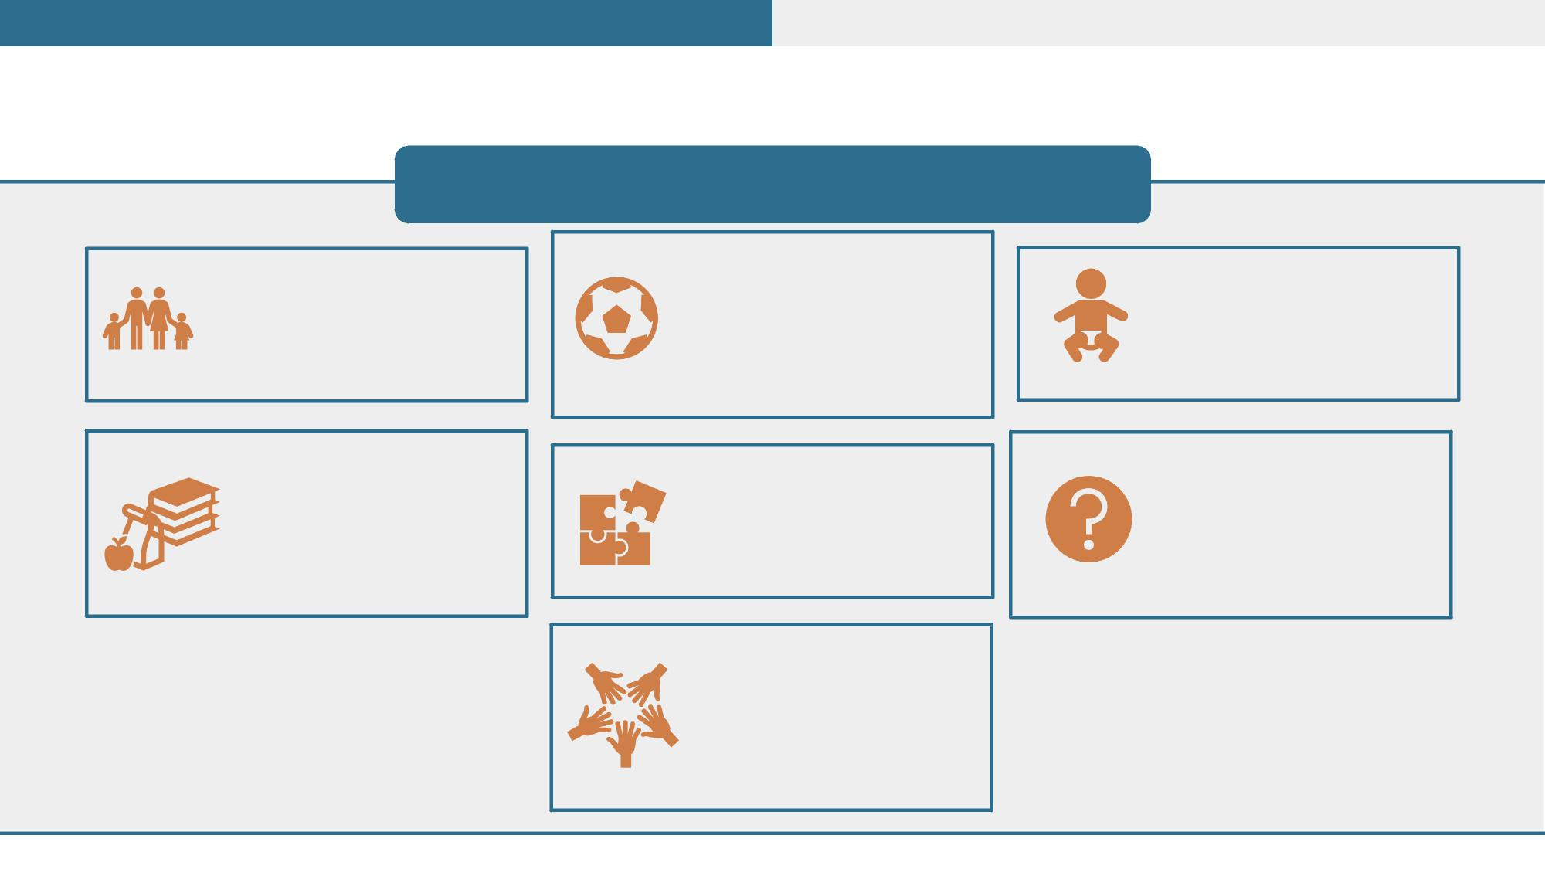
Module 1
Module 2
As Needed Screenings (2 of 2)
Examples of As Needed Screenings (not limited to):
A child joining a sports
team or camp receives
a pre-participation
medical history and
physical examination
A child receiving foster
care receives a medical
history and physical
examination
A child with a history of
perinatal problems
receives additional
screenings
A child enrolling in
school receives a pre-
participation medical
history and physical
examination
A child with a history of
developmental
disability receives
additional screenings
A child or their
parent/caregiver or
guidance receives
additional anticipatory
guidance
A child entering
California as a refugee
receives a medical
history and physical
examination
25

Slide 26



Module 1
Module 2
Medi-Cal for Kids & Teens
Diagnostic Services
When diagnostic and/or treatment
services are indicated as a result of a
screening, providers must take all
reasonable steps, including follow-up, to
ensure enrollees receive medically
necessary diagnostics and treatment no
later than 60 days after screening
Screening Services
Screenings are designed to identify health and developmental issues as early as possible
Diagnostic Services
A child’s diagnosis may be provided by a physician or other qualified practitioner
26

Slide 27
Module 1
Module 2
Medical Necessity (1 of 2)
» Medi-Cal for Kids & Teens defines medical necessity broader for children and
youth enrolled in Medi-Cal compared to adults. If a service is medically necessary
and is included within any of the mandatory or optional categories of Medicaid-
covered services listed in Section 1905(a) of the Social Security Act, then it must be
provided to the child, even if the service is not included in the Medi-Cal State Plan.
» Under Medi-Cal for Kids & Teens, medical necessity is defined under federal and
state requirements as services correcting or ameliorating conditions, defects, and
physical and mental illnesses.
» A service need not cure a condition in order to be covered under Medi-Cal for
Kids & Teens. Services that maintain (by preventing a condition from worsening
or preventing additional health problems) or improve a child’s condition are
covered because they “ameliorate” a condition.
27

Slide 28

Module 1
Module 2
Medical Necessity (2 of 2)
» Medical necessity must be determined on a case-by-case, individual basis and consider all aspects
of the child’s needs
» Providers play a significant role in medical necessity determinations, as they are responsible for
justifying why a service is medically necessary for a child to their contracted managed care plan
» DHCS and its managed care plans may require prior authorization in order to safeguard
against unnecessary use of services
Prior authorization cannot delay or deny medically necessary services
Limits based on a monetary cap or budgetary constraints may not be imposed; for example, if it is
medically necessary for a child to have 20 hours per week of private duty nursing, then the
managed care plan cannot limit the service to 10 hours per week
» California’s managed care plans may not use a definition of medical necessity that is more
restrictive than the federal definition, which is the same definition as in California law
28

Slide 29

Module 1
Module 2
Medical Necessity Review Criteria
What is a medically necessary service per Medi-Cal for Kids & Teens?
Medically Necessary Not Medically Necessary
1' Service is reasonable, appropriate, and effective
method to correct, maintain, or ameliorate the child’s
medical needs
1' Service is in accordance with current medical
standards or practices
1' Service’s scope (e.g., number of hours of skilled
nursing care) is sufficient to address the child’s needs
1' Service is necessary to ensure for a safe environment
for the child to ameliorate a given condition
1' Service is experimental or investigational (considered
on a case-by-case basis)
1' Service is primarily for caregiver convenience (e.g.,
DME duplicated to be provided at divorced parents’
homes)
1' Service is more expensive than an equally effective
and less expensive, available service; however, cost is
not a basis for determining a service should not be
provided
 |  | If the service is determined to be medically necessary, the service must be covered if it can be covered under Medicaid, even if it is not in the Medi-Cal State Plan or not provided to adults, or if the child does not have a diagnosis
29

Slide 30

Module 1
Module 2
Second Opinions
» If a provider requests a service for a child that is
denied by the managed care plan, then the provider
can request a second opinion from a qualified health
professional
» Managed care plans must permit second opinions
through their Utilization Management Program
that ensures appropriate processes are used to
review and approve the provision of medically
necessary covered services in Medi-Cal Managed
Care
30

Slide 31
Module 1
Module 2
Medical Necessity Review Criteria:
Occupational Therapy Example
 | » » | An 8-year-old enrolled in a Medi-Cal managed care plan receives a periodic developmental screening at their well-child checkup that indicates a developmental delay The pediatrician prescribes the child occupational therapy services
 | » | The pediatrician submits a prior authorization request for occupational therapy to the Medi-Cal managed care plan
 | » | The managed care plan conducts medical necessity review and determines the occupational therapy services are not medically necessary
 | » | The pediatrician requests a second opinion through the managed care plan’s Utilization Management Program with another qualified health professional
 | » | The other qualified health professional agrees with the pediatrician’s assessment that the therapy is medically necessary for the child and submits results to the managed care plan
 | » | The managed care plan reviews the second opinion and determines the occupational therapy services are medically necessary
 | » | The pediatrician refers the child to a licensed occupational therapist and provides follow-up care
31

Slide 32

Module 1
Module 2
Settings for Medi-Cal for Kids & Teens Services:
School-Based Services
» Medi-Cal-enrolled children and youth under age 21 can receive the following Medi-Cal covered services
from schools:
Nutritional assessments and counseling
treatments
Vision assessments and screenings
Physical, respiratory, occupational, and
speech- language therapy
Audiology assessment, treatments, and
hearing screening tests
Psychology and counseling services
and psychosocial assessments
Orientation and mobility services
Developmental assessments
Specialized medical transportation
Health education and anticipatory
guidance
School health aide services
(administration of specialized physical
health care services and assistance
with Activities of Daily Living)
32

Slide 33

Module 1
Module 2
Settings for Medi-Cal for Kids & Teens Services:
Out-Of-State Services
 |  | » DHCS and its managed care plans must cover out-of-state services if the service would be covered in-state, and: Service is required because of an emergency; The child is out of state and the child’s health would be endangered if they were required to travel to their home state; Service is more readily available in another state; or The child lives in an area that often utilizes services in another state (i.e., if area borders another state)
33

Slide 34

Module 1
Module 2
Settings for Medi-Cal for Kids & Teens Services:
Telehealth Modality
» Medi-Cal covered benefits or services may be provided via telehealth if:
The treating provider believes the benefits or services are clinically appropriate to deliver via
telehealth;
Benefits or services meet procedural definition and components of CPT or HCPCS codes and
Medi- Cal provider manual guidelines; and
Benefits or services meet all laws regarding confidentiality and a patient’s right to their
medical information
» Benefits or services may be delivered via synchronous video, synchronous audio-only, or asynchronous
store and forward, so long as those services meet the standard of care and billing code requirements
that apply to in-person service. Include the following modifiers when billing for services delivered via
telehealth:
Synchronous video: 95
Synchronous audio-only: 93
Asynchronous store and forward: GQ
» Medi-Cal enrolled children or youth may request or decline delivery of services via telehealth modality
34

Slide 35

Module 1
Module 2
Required Services to Support Access (1 of 2)
 |  | Necessary Transportation To and From Appointments » Providers must offer and assist with arranging non-emergency medical transportation (NEMT) and non-medical transportation (NMT) so children/youth under age 21 can receive Medi-Cal for Kids & Teens services NEMT is transportation by ambulance, wheelchair van, or litter van for children whose medical and physical condition does not allow them to travel by public or private transportation Providers must submit a Physician Certification Statement (PCS) form to the managed care plan for NEMT prior authorization
 |  | NMT is private or public transportation; families or the child/youth will need to attest to their provider verbally or in writing that they have an unmet transportation need and all other currently available resources have been reasonably exhausted Providers need to confirm with the managed care plan if prior authorizations are required for NMT services, as it is up to the managed care plan to determine
 |  | Families or the child/youth may request or refuse transportation assistance at any time
 |  | Related Travel Expenses
 |  | » California’s managed care plans must cover related travel expenses for medically necessary services at the child/youth’s request, including the cost of meals and lodging for a child and parent, caretaker, relative, friend, or attendant for the purpose of obtaining needed medical care
Providers can
direct families
to the Medi-
Cal Member
Help Line at
1-800-541-
5555 or their
Medi-Cal
Managed
Care Plan for
help accessing
transportation
and travel
supports
35

Slide 36
Module 1
Module 2
Required Services to Support Access (2 of 2)
Language Assistance
» Managed care plans must provide oral interpretation for any non-English speaking family or child/youth, free of charge, at
all medical encounters (such as an outpatient visit) and certain non-medical encounters (such as
scheduling appointments)
» Sign language interpreter services must also be provided during all medical and certain non-medical encounters
» Managed care plans must translate the member handbook and provider directory into prevalent non-English
languages when at least 3,000 or 5% of the managed care plan’s members speak a non-English language,
whichever is lower
» The provider directory must include cultural and linguistic capabilities of each provider, including
languages (including ASL) offered by the provider or a skilled medical interpreter at the provider’s office, or access to
language line interpreters
» Families, children and youth, and providers can call the Office of Civil Rights at (916)-440-7370, 711 (California
State Relay) or the Medi-Cal Member Help Line at 1-800-541-5555 for assistance accessing language services
» Managed care plans must provide alternative formats of the member handbook; provider directory; and
dental, termination, and appeal notices such as braille, audio format, large print (no less than 20-point Arial font),
and accessible electronic format (e.g., data CD)
Appointment Scheduling Assistance
» Providers must offer and provide, as requested, assistance with scheduling appointments for Medi-Cal for Kids &
Teens services
36

Slide 37
Module 1
Module 2
Informing Families of Medi-Cal for Kids & Teens
Services
Providers play an important role in communicating about Medi-Cal for Kids & Teens to children and families. A
combination of face-to-face, oral, and written communication is recommended. Providers must inform all
Medi-Cal eligible families of the services available to them under Medi-Cal for Kids & Teens, including:
Benefits of preventive
health and dental care
Tips and information for
choosing a health or
dental care provider
Nature and scope of
Medi-Cal for Kids & Teens
medical and dental
services
Appointment scheduling
and transportation
assistance availability
Need for prompt
diagnosis of suspected
defects, illnesses, diseases
or other conditions
Availability of treatment
for problems diagnose
during screening
Referrals to other
providers for additional
services not offered
Ability to ask for and
receive services, even if
the services were initially
denied
DHCS and its managed care plans must identify children that are underutilizing Medi-Cal for Kids & Teens screenings
and preventive services and ensure outreach to these children
³⁷
37

Slide 38
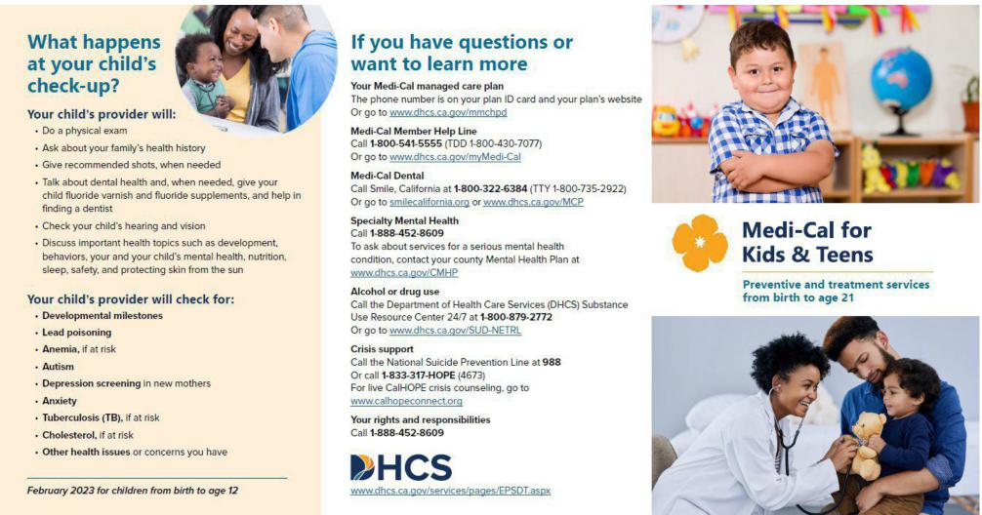
Module 1
Module 2
Medi-Cal for Kids & Teens
Enrollee Brochures
DHCS has developed brochures for children and families enrolled in Medi-Cal to increase knowledge and
awareness of Medi-Cal for Kids & Teens. There are two brochures: (1) children ages 11 and under and (2)
children and youth ages 12 through 20).
» Brochures are available in multiple languages here for providers to print and share in offices » Providers are encouraged to print and share brochures broadly with families enrolled in Medi-Cal » Managed care plans will distribute these brochures to families with children on an annual basis
38

Slide 39
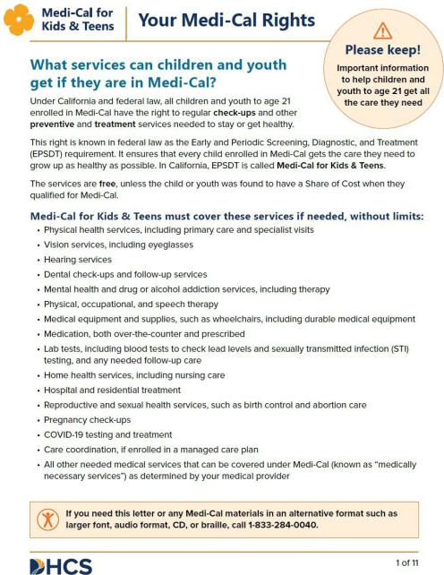
Module 1
Module 2
Medi-Cal for Kids & Teens
Your Medi-Cal Rights Letter
DHCS has developed a letter for children and families enrolled in Medi-Cal outlining their rights in accessing
Medi-Cal for Kids & Teens, as well as what to do when care is denied, delayed, reduced, or stopped.
» The letter is available in multiple languages here for providers to print and share in offices » Providers are encouraged to print and share the letter broadly with families enrolled in Medi-Cal » Managed care plans will distribute the letter to families with children on an annual basis |  | 39

Slide 40
Module 1
Module 2
Test Your Learning
» Can maternal depression screenings be provided during an infant’s well-child visit?
» Can providers support children and families in obtaining transportation to a medical appointment?
» A child with a developmental disability needs additional screenings outside of the Medi-Cal for Kids &
Teens Periodicity Schedule. Are these additional screenings covered by Medi-Cal?
» If a child breaks their glasses, can they get a new pair?
» If a child needs 10 hours of home health services but their Medi-Cal managed care plan only approved 8
hours, how can the provider get the decision reviewed?
» What age does Medi-Cal for Kids & Teens apply to – up to age 18 or 21?
40
Notes:
#1 – Yes
#2 - Yes
#3 - Yes – If the PCP identifies a need, additional screenings are covered
#4 - Yes – If a child breaks their glasses, the PCP can prescribe a new pair.
#5 – If it is needed provider can submit
#6 - Up to Age 21

Slide 41


Medi-Cal for Kids & Teens
Training Modules
 | Module 1: What is Medi-Cal for Kids & Teens and How Does it Work?
 | Module 2: Deep Dive into Behavioral Health Services, California Children’s Services Program, and Skilled Nursing Services
41

Slide 42

Module 1
Module 2
In This Module You Will Learn...
» What are Medi-Cal for Kids & Teens covered mental health services and
SUD services
» How non-specialty mental health and specialty mental health differ from
each other in Medi-Cal
» Which children are eligible for California Children’s Services (CCS) or
CCS Whole Child Model (WCM) and why
» How children can qualify for Medi-Cal for Kids & Teens covered
skilled nursing services
42

Slide 43


Module 1
Module 2
Mental Health Services
Medi-Cal for Kids & Teens covers all medically necessary mental health services for children and youth under
age 21 enrolled in Medi-Cal. There are two different systems that the State leverages to deliver mental health
services depending on the child and youth’s level of need, including:
Specialty Mental Health Service (SMHS)
» County mental health plans are responsible for
providing medically necessary SMHS for children
and youth under the age of 21
▪ If a child/youth meets the criteria for SMHS, then
they should be receiving any SMHS from the
mental health plan, except in cases where the No
Wrong Door policy applies (see slide 45))
» SMHS are “carved out” of Medi-Cal Managed Care
Non-Specialty Mental Health
Services (NSMHS)
» Managed care plans are responsible for
providing medically necessary NSMHS for
children and youth under the age of 21
» NSMHS are “carved in” to Medi-Cal
Managed Care
 | Children and youth under age 21 do not require a diagnosis in order to receive mental health services. 43 Updated May 2024

Slide 44
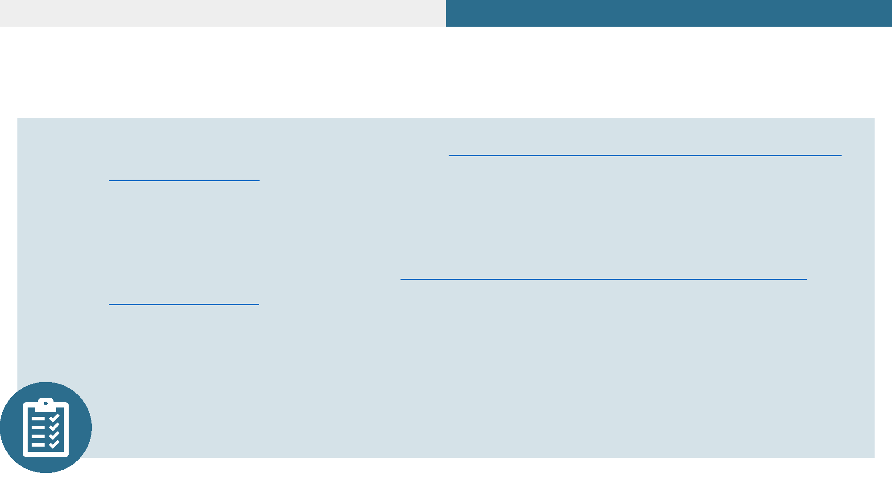
Module 1
Module 2
Mental Health Services Screening and
Transition Tools
» Providers are NOT required to use theYouth Screening Tool for Medi-Cal Mental
Health Services for children and youth under age 21 who are not currently
receiving mental health services and who contact the Medi-Cal managed care plan
or county mental health plan directly seeking mental health services
» Providers are required to use theTransition of Care Tool for Medi-Cal Mental
Health Services to ensure enrollees who are receiving mental health services from
one delivery system receive timely transition of care referrals or services referrals to
their managed care plan or county mental health plan
» Both county mental health plan and managed care plan providers will leverage this
tool statewide to better identify appropriate behavioral health delivery systems and
services that are child and family-centered
44
Updated May 2024

Slide 45
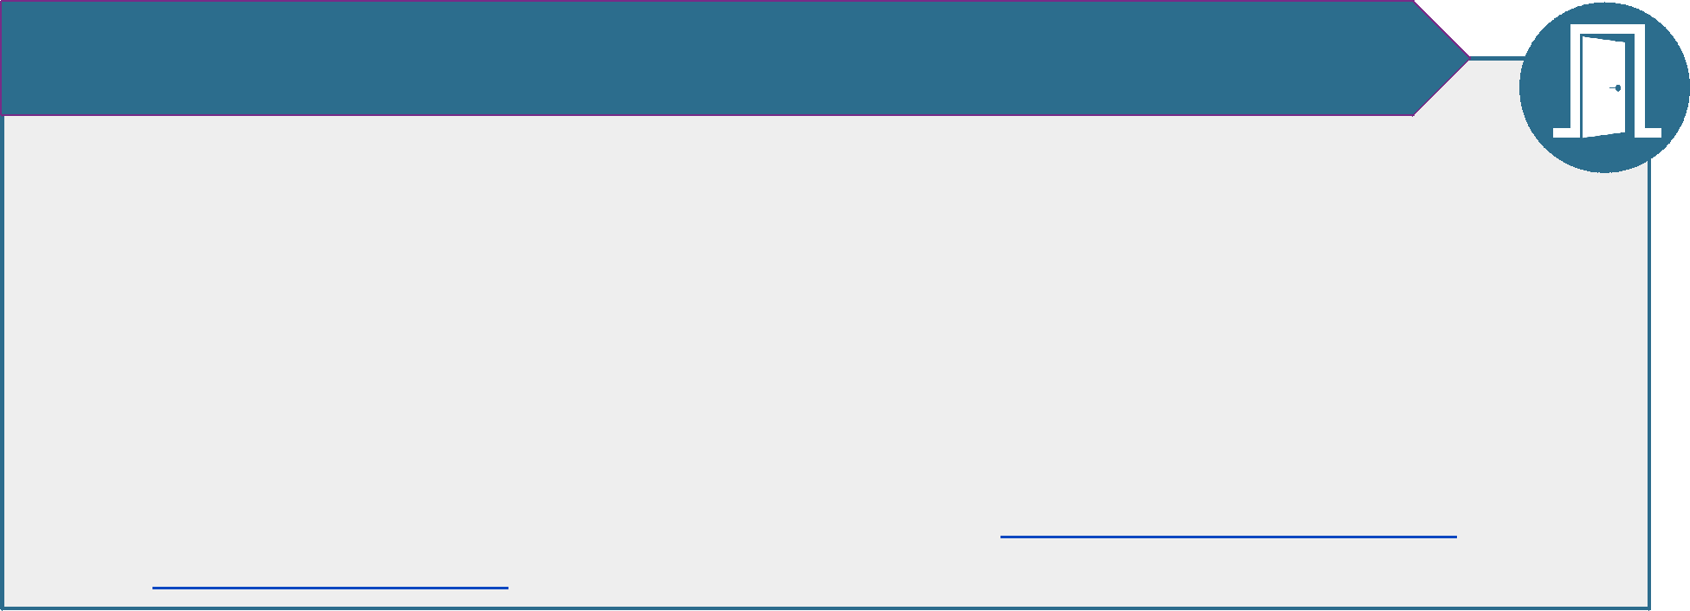
Module 1
Module 2
No Wrong Door Policy
DHCS implemented a “No Wrong Door” policy in July 2022 to ensure enrollees receive mental health services
without delay regardless of where they initially seek care.
Clinically appropriate NSMHS and SMHS are covered and reimbursable even when:
> Services are provided prior to determination of a diagnosis, during the assessment period, or
prior to determination of whether NSMHS or SMHS access criteria are met;
> Services are not included in an individual treatment plan; (currently only applies to NSMHS;
guidance forthcoming for SMHS)
> The child has a co-occurring mental health condition and SUD; or
> NSMHS and SMHS services can be provided concurrently, if the mental health plan and managed
care plan coordinate to provide the services and ensure they are not duplicated (each plan would
only be responsible for the services they are providing). See the No Wrong Door for Mental Health
Services Webinar (slide 17) for more information regarding providing concurrent services.
45
Updated May 2024

Slide 46

Module 1
Module 2
Non-Specialty Mental Health Services (NSMHS)
NSMHS (formerly known as Mild to Moderate services) include a variety of behavioral interventions that promote the
functioning of children and youth and prevent or minimize the adverse effects of behaviors that interfere with
learning and social interaction. Managed care plans must provide or arrange all medically necessary NSMHS for
children and youth under age 21 regardless of their level of distress or impairment, or the presence of a diagnosis.
» NSMHS include:
Mental health evaluation and treatment, including individual, group and family psychotherapy
Dyadic services for children and their caregiver(s)
Psychological and neuropsychological testing, when clinically indicated to evaluate a mental health
condition
Outpatient services for purposes of monitoring drug therapy
Psychiatric consultation
Outpatient laboratory, drugs (not including outpatient pharmacy benefits covered under Medi-Cal
Rx), supplies, and dietary supplements (e.g., folic acid, vitamin D, vitamin B12)
» Provider types include:
Licensed Clinical Social Worker • Psychiatric Physician Assistant
Licensed Professional Clinical Counselor • Psychiatric Nurse Practitioner
Licensed Marriage and Family Therapist • Psychiatrist (as consistent with the
Licensed Psychologist practitioner’s training and licensing
Associate provider types may render services under requirements)
a supervising clinician
For more
information,
please review
the Non-
Specialty
Mental Health
Services:
Psychiatric and
Psychological
Services
Provider
Manual
46

Slide 47

Module 1
Module 2
County Specialty Mental Health Services
Each county mental health plan must provide or arrange all medically necessary SMHS for children and youth
under age 21 enrolled in Medi-Cal who require more intensive mental health services.
County mental health plans must make individualized determinations of each child’s need for SMHS. Examples include, but are
not limited to:
» Intensive Care Coordination (ICC) (e.g., targeted case
management for children in SMHS)
» Intensive Home-Based Services (IHBS) (e.g., interventions
designed to correct or ameliorate conditions that interfere
with functioning, and improve the family’s ability to help
the child successfully function at home/school/community)
» Therapeutic Foster Care (TFC) (e.g., short-term, trauma-
informed, intensive SMHS for children with complex
emotional and behavioral needs; in TFC, children are placed
with trained and intensely supervised TFC parents)
» Therapeutic Behavioral Services (TBS) (e.g., short-term,
intensive services for children with a SED)
» Psychiatric Health Facility Services and/or Inpatient
Hospital Services (e.g., 24-hour inpatient care)
» Crisis Intervention, Stabilization, and/or Residential
Services (e.g., community-based crisis intervention,
short-term)
» Day Treatment Intensive and/or Rehabilitation Services
(e.g., group therapy, skill building groups, short-term)
» Peer Support Services (optional)
» NSMHS-
if a child meets the criteria for SMHS, then they may
be receiving NSMHS from the Managed Care Plan,
where the No Wrong Door policy applies (see slide
45)
SMHS may be provided during an assessment period for the child prior to the determination of a diagnosis or
whether SMHS access criteria are met (see next slide for access criteria).
47
Updated May 2024

Slide 48
SMHS Access Criteria
For more
information, please
review BHIN 21-073
Covered SMHS shall be provided to children and youth who meet
either of the following criteria, (1) or (2) below:
The child is at high risk for a mental health disorder due to experience of trauma (i.e., scores in the high-risk range
under a trauma screening tool, involvement in the child welfare system, juvenile justice involvement, or experiencing
homelessness)
OR
The child meets both requirements in a) and b), below:
a) The child has at least one of the following:
A significant impairment
A reasonable probability of significant deterioration in an important area of life functioning
A reasonable probability of not progressing developmentally as appropriate
A need for SMHS, regardless of presence of impairment, that are not included within the mental health
benefits that a Medi-Cal managed care plan is required to provide
AND
b) The child’s condition as described in (2) above is due to one of the following:
A diagnosed mental health disorder
A suspected mental health disorder that has not yet been diagnosed
Significant trauma placing the child at risk of a future mental health condition, based on the assessment of a
licensed mental health professional
48
Updated May 2024

Slide 49

Module 1
Module 2
Substance Use Disorder Services (1 of 2)
Medi-Cal for Kids & Teens covers all medically necessary substance use disorder (SUD) treatment, such as
outpatient care, residential treatment services, and withdrawal management. SUD services are primarily
provided through DMC or DMC-ODS programs, depending on the county, and some SUD services are provided
by managed care plans.
SUD treatment services are provided to eligible Medi-Cal enrollees,
including children and youth under age 21, via county-run Drug
Medi-Cal (DMC) or Drug Medi-Cal Organized Delivery System
(DMC-ODS) programs:
» Counties have the option to participate in the DMC-ODS program
and provide an expanded array of SUD treatment services to
Medi-Cal enrollees
» All counties, regardless of their participation in DMC-ODS, are
required to provide all applicable SUD services needed to correct
or ameliorate health conditions that are coverable under Medi-Cal
for Kids & Teens
49

Slide 50
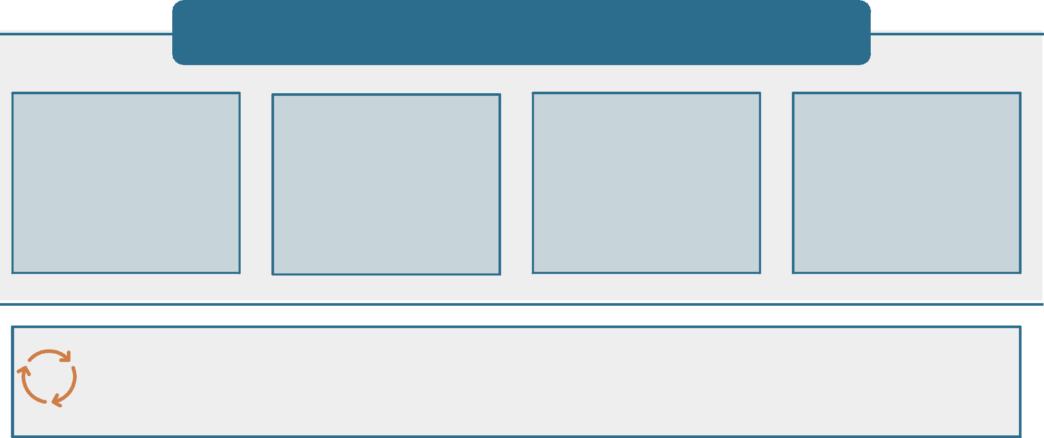
Module 1
Module 2
Substance Use Disorder Services (2 of 2)
Though most SUD services are provided via DMC or DMC-ODS for
children and youth, managed care plan providers must provide:
Early intervention SUD
services for children and
youth determined to be
at risk of SUD (e.g., any
service component
covered under the
outpatient level of care)
Medications for
Addiction Treatment
(MAT) available in
primary care, inpatient
hospital, and emergency
departments
SABIRT screening (see
slide 22) to children
starting at age 11 who
are at risk of developing
a SUD
Emergency services to
stabilize the child
(including voluntary
inpatient detoxification)
Some children may qualify for both SMHS and SUD services if they have a co-occurring SUD and mental
health condition. Providers are required to coordinate and collaborate across delivery systems to
ensure clinical integration between county mental health plans, DMC or DMC-ODS counties, and managed
care plans, and to ensure non-duplicative services
50

Slide 51

Module 1
Module 2
Mobile Crisis Services
Medi-Cal for Kids & Teens covers qualifying mobile crisis services, including an initial face-to-face crisis
assessment, crisis response and stabilization, crisis planning, referrals to ongoing services and supports, and
follow-up. Mobile crisis services offer community-based interventions to individuals experiencing a mental
health or substance use crisis and are available to Medi-Cal enrollees 24 hours a day, 365 days a year.
» Crisis intervention and habilitation services, including when delivered in a mobile modality, are
always covered for children and youth under age 21
» Mobile crisis services can provide relief to youth experiencing a behavioral health crisis; reduce
the risk or danger and subsequent harm; and avoid unnecessary emergency department care,
psychiatric inpatient hospitalizations, and law enforcement involvement
» In January 2023, counties began implementing the qualifying mobile crisis services benefit in the
SMHS and DMC or DMC-ODS delivery systems
Counties will develop a standardized screening tool to determine when mobile crisis teams
should be dispatched and other policies and procedures to ensure mobile crisis services are
delivered effectively to children and youth
The qualifying mobile crisis services benefit will be available statewide in SMHS and DMC or
DMC-ODS delivery systems by December 31, 2023
51

Slide 52


Module 1
Module 2
Psychiatric Collaborative Care Management
Services
> Overview. Providers can bill for psychiatric collaborative care management
services when they reach out to a psychiatric or addiction medicine consultant to
help treat a child’s mental health and/or SUD
> Consent. The child and their parent or caregiver must give permission to consult with
relevant specialist; consent can be verbal and must be documented in medical record
Starting at age 12 and older, a child may, without parental consent, receive
services related to drug and alcohol abuse treatment/counseling and mental
health outpatient care
> Billing Codes & Services. Reimbursable CPT codes include 99492 (70 minutes in first
month), 99493 (60 minutes in subsequent month), and 99494 (additional 30 minutes)
for the following services in collaboration with a consulting provider:
Outreach and engagement in treatment with another qualified health care
professional
Initial assessment of the child with a validated rating scale and
development of a treatment plan
Review and modifications of the plan with the consulting provider
Tracking patient follow-up and entering info in a registry
Participating in weekly caseload consultation with consulting provider
Providing brief interventions
99492 and 99493 can
be billed once per
month, but not in the
same month. 99494
can be billed twice per
month
For additional
information, see the
Evaluation &
Management Provider
Manual re: Psychiatric
Collaborative Care
Management Services
52

Slide 53
Module 1
Module 2
County SMHS:
Intensive Home-Based Services (IHBS) Example
 | ,, ,, ,, | A ten-year-old child enrolled in Medi-Cal managed care has been experiencing issues with self- regulation and behavioral outbursts in school The child’s pediatrician screens the child using the standardized screening tool and determines the child would benefit from SMHS The child’s pediatrician refers the child to the county mental health plan
 | ,, | A pediatric psychologist paneled at the county mental health plan conducts an additional assessment and determines that IHBS supports (e.g., interventions designed to correct or ameliorate conditions that interfere with functioning, and improve the family’s ability to help the child successfully function at home/school/community) would be appropriate to effectively serve the child’s intensive behavioral needs and engage the child’s caregivers to support building functional skills
 | ,, | The psychologist submits the IHBS mental health documentation requirements prescribed by the county mental health plan, consistent with the mental health plan’s process for authorizing IHBS
 | ,, The county mental health plan agrees with the psychologist in determining that the IHBS services are medically necessary based on the child’s strengths and needs
 | ,, | The county mental health plan delivers IHBS to the child in their home and community setting 53

Slide 54

Module 1
Module 2
California Children’s Services (CCS) Requirements
for Primary Care Providers (1 of 2)
CCS is an important component of the Medi-Cal system of care available to qualifying children and youth under
age 21 with certain diseases or health problems.
' The CCS Program, which is administered as a partnership between county health departments and DHCS, provides diagnostic and treatment services, medical case management, and physical and occupational therapy services ' Care for children enrolled in CCS is provided by CCS-paneled providers, CCS- approved special care centers (SCCs), and approved pediatric acute care hospitals ' The CCS Medical Therapy Program (MTP) provides direct physical and occupational therapy services for a subset of CCS-eligible children with physical disabilities
 |  | Examples of CCS-eligible conditions include, but are not limited to, cystic fibrosis, hemophilia, cerebral palsy, heart disease, cancer, lead poisoning, and traumatic injuries.
' Note: A child can be eligible for CCS services regardless of whether they are eligible for Medi-Cal or enrolled in a Medi-Cal managed care plan |  | 54

Slide 55
Module 1
Module 2
California Children’s Services (CCS) Requirements
for Primary Care Providers (2 of 2)
Anyone can make a referral to the CCS Program, if they suspect that a child is eligible for CCS. Primary care
providers or specialists must provide a baseline health assessment and diagnostic evaluation with sufficient clinical
to establish – or raise a reasonable suspicion – that a child has a CCS-eligible medical condition.
» Children with CCS-eligible conditions must be referred to the local CCS Program on the same day after the
condition is identified
» Referrals can be made via phone, secure email, mail, or fax, and include supporting medical documentation
sufficient to allow for a medical eligibility determination
» Access here for the list of phone and fax numbers for each local CCS Program
Providers must continue to provide all covered services until the CCS Program eligibility is determined, and the
managed care plan must reimburse the provider for those services.
55

Slide 56
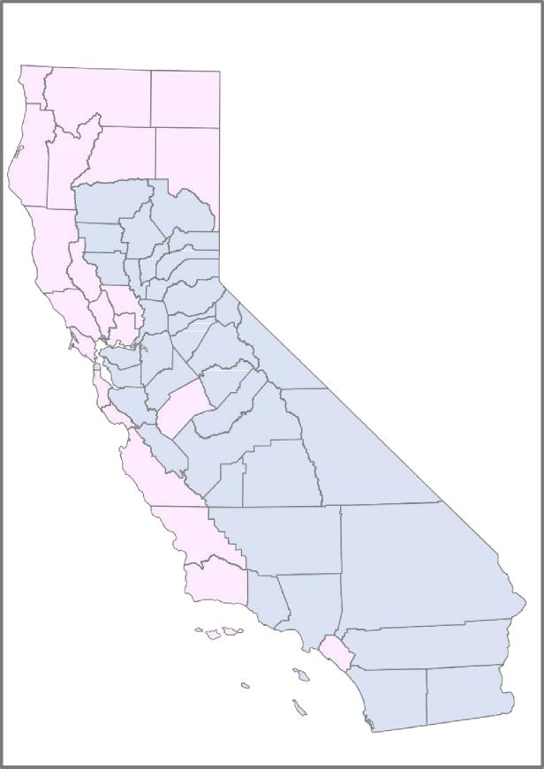
Module 1
Module 2
Classic CCS Counties & CCS WCM Counties
» California’s 58 counties provide CCS through two different models:
In Classic CSS counties, the treatment for the CCS qualifying condition, including
medical case management, is provided directly through the CCS county office
In CCS Whole Child Model (WCM) counties, the treatment for the CCS qualifying
condition, including medical case management, is “carved in” to the managed
care plan’s responsibility
» The eligibility criteria for CCS are the same in both Classic CCS and CCS WCM counties
» If the local CCS Program or DHCS finds that the child’s condition is not medically
eligible, then the managed care plan in both Classic CCS and CCS WCM counties
remains responsible for providing and reimbursing for the cost of services if
determined to be medically necessary
» Local CCS county offices or DHCS determine if a child is eligible for CCS in both Classic
CCS and CCS WCM counties
Counties with populations greater than 200,000 – known as independent
counties – have county staff perform medical eligibility determinations
Counties with populations less than 200,00 may choose to be independent
counties or dependent counties; DHCS is responsible for determining
medical eligibility for dependent counties
56
Counties in pink are CCS WCM counties and
counties in blue
are CCS counties (see
Appendix 2 for a full county list)

Slide 57

Module 1
Module 2
Medi-Cal for Kids & Teens
Skilled Nursing Services (1 of 2)
Skilled nursing services are critical for children and youth with serious physical health conditions, many of
whom often qualify for CCS.
» Children and youth under age 21 may be eligible for Medi-Cal for Kids & Teens Skilled Nursing Services,
including:
Private Duty Nursing (PDN) is skilled nursing services provided by a licensed nurse (RN or LVN) on a shift
basis at a child’s home for children who require more individualized and continuous care than what would be
provided by a visiting nurse; otherwise known as ‘shift’ nursing
Pediatric Day Health Care (PDHC) is skilled nursing services provided as day programs at PDHC facilities of
less than 24 hours, including (but not limited to) comprehensive case management; nutrition and nursing
services; developmental and educational services; and physical, occupational, speech therapy
 | Limits based on a monetary cap or budgetary constraint may not be imposed; for example, if a provider determines it is medically necessary for a child to have 20 hours per week of private duty nursing, then the managed care plan cannot limit the service to 10 hours per week
57

Slide 58
Module 1
Module 2
Medi-Cal for Kids & Teens
Skilled Nursing Services (2 of 2)
Providers must refer a child for skilled nursing services if they determine the services are medically
necessary for the child. Service authorization for PDN and PDHC include:
CCS–Eligible Members
CCS WCM–Eligible Members
Non-CCS-Eligible Members
» Providers must fax or secure email a
service authorization request (SAR)
to the child’s local CCS County
office or upload the SAR into the
Provider Electronic Data Interchange
(PEDI) for the local CCS county
office or DHCS to adjudicate the
PDN or PDHC service request
» Providers must submit with the SAR
a Plan of Treatment (POT) signed by
a CCS paneled physician and
supporting clinical documentation
such as medical records and
discharge summary notes
» Providers must submit a prior
authorization request to the
managed care plan to approve
or deny the PDN or PDHC
service request
» Providers must submit with the
prior authorization request a
POT, supporting clinical
documentation, and other
information, as specified by the
managed care plan for review
and authorization
» Providers must submit prior
authorization requests to the
managed care plan to approve
or deny the PDN or PDHC
service request
» Providers must submit with the
prior authorization request a
POT, supporting clinical
documentation, and other
information, as specified by the
managed care plan for review
and authorization
5858

Slide 59

Module 1
Module 2
Medical Necessity Review Criteria:
Private Duty Nursing Example
 | » » | An infant with chronic lung disease has a tracheostomy and ventilator and requires PDN services The infant is enrolled in the CCS Program and enrolled in a managed care plan in a Classic CCS County
 | » | The CCS-paneled provider submits a SAR requesting RN-level PDN services to be performed in the child's home; attachments include the POT signed by the CCS paneled physician and supporting clinical documentation
 | » | The CCS Program adjudicator determines that the services requested relate to the CCS-eligible condition and they conduct a medical-necessity review and determine that the services are within the scope of an LVN
 | » | The CCS Program adjudicator modifies the SAR to reflect the appropriate provider type to render the PDN services and approves the PDN services and units
59

Slide 60
Module 1
Module 2
Test Your Learning
> Do children without diagnosed mental health conditions qualify for mental health services
provided by managed care plans and/or mental health plans?
> Can a child receive services from a managed care plan, county mental health plan, and Drug
Medi-Cal (DMC)/Drug-Medical Organized Delivery System (DMC-ODS) county at the same
time?
> If you believe a child would benefit from family therapy or other supports, are those services
available under Medi-Cal for Kids & Teens?
> How does a child enrolled in Medi-Cal managed care and not eligible for CCS receive skilled
nursing services?
60
Notes:
Now let’s test your knowledge.
Question #1 - Children and youth under age 21 do not require a diagnosis in order to receive mental health services. Slide 43
Question #2 Some children may qualify for both SMHS and SUD services if they have a co-occurring SUD and mental health condition. Providers are required to coordinate and collaborate across delivery systems to
ensure clinical integration between county mental health plans, DMC or DMC-ODS counties, and managed care plans, and to ensure non-duplicative services
Question #3
Question #4 Providers must refer a child for skilled nursing services if they determine the services are medically necessary for the child. Go to slide 58
Providers must submit prior authorization requests to the managed care plan to approve or deny the PDN (Private Duty Nurse) or PDHC (Pediatric Day Health Care) service request
Providers must submit with the prior authorization request a POT, supporting clinical documentation, and other information, as specified by the managed care plan for review and authorization

Slide 61

Appendix
61

Slide 62
Appendix
Billing Codes
Service Category | Billing Codes
Blood lead screening | CPT 36415, 36416, 83655, 99401, 99402, 99403, 99404
Developmental screening | CPT 96110
ASD screening | CPT 96110 and modifier KX
Depression screening | HCPCS G8431 and G8510
Postpartum depression screening | HCPCS G8431 and G8510
Vision screening | CPT 99173*, 99381-99385 and 99391-99395 *For school-based enrolled Medi-Cal providers only
Hearing screening | CPT 92551 and 92552; ICD-10-CM diagnosis codes Z00.121, Z00.129, Z01.10, or Z01.11
Oral health screening | CPT 99188, 99381 – 99383, 99391 – 99393; HCPCS D1206
ACEs/trauma screening | HCPCS G9919, G9920
Dyadic services | HCPCS H1011, H2015, H2027, T1027
As needed screenings | As needed screenings should be billed using the appropriate preventive medicine CPT code and ICD-10 CM diagnosis code Z00.8 (encounter for other general examination)
62

Slide 63
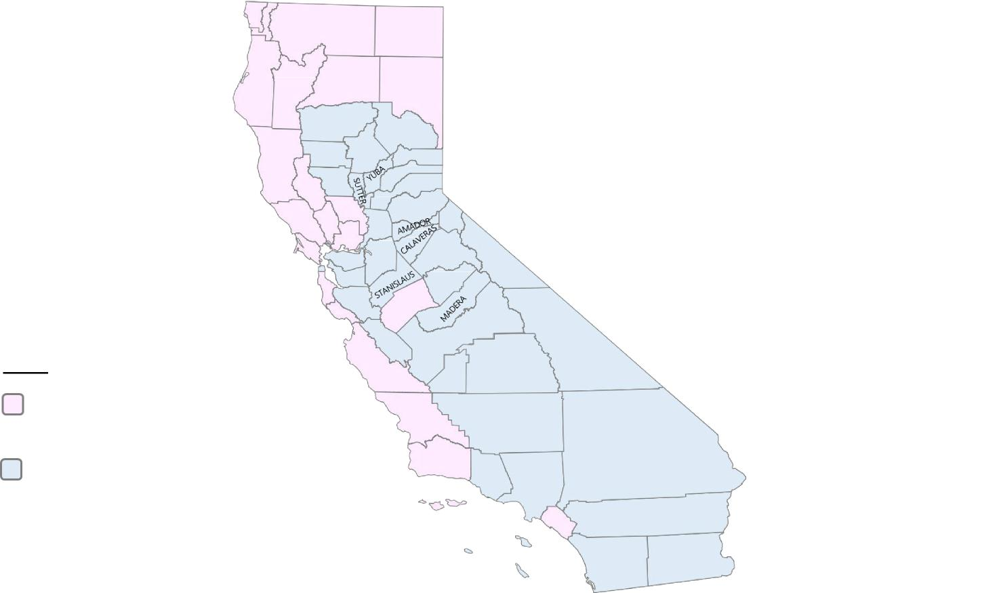
Appendix
Classic CCS Counties & CCS WCM Counties (2 of 2)
DEL
NORTE SISKIYOU
MODOC
HUMBOLDT TRINITY SHASTA
LASSEN
TEHAMA
PLUMAS
SIERRA NEVADA PLACER
MENDOCINO
GLENN
COLUSA LAKE
BUTTE
SONOMA
YOLO
EL DORADO
ALPINE
NAPA
SACRA-MENTO
MARIN
SOLANO
SAN FRANCISCO
SAN
CONTRA JOAQUIN COSTA
TUOLUMNE
MONO
SAN MATEO
ALAMEDA
MARIPOSA
SANTA CLARA
MERCED
INYO
SANTA CRUZ
FRESNO
KEY
SAN BENITO
CCS WCM
counties
CCS counties
TULARE
MONTEREY KINGS
SAN LUIS OBISPO
KERN
SANTA BARBARA
SAN BERNARDINO
LOS
VENTURA ANGELES
ORANGE
RIVERSIDE
SAN DIEGO
IMPERIAL
63

Slide 64
Sources
For the list of sources related to this training, please refer to the“MCKT Provider Training Sources” located on the MCKT Website, Provider Information page.
64

