Slide 1

Prospect Medical IT Security Awareness:
Practical Tips to Protect Sensitive Data

Slide 2

Our fundamental philosophy toward patient and employee privacy and security should be:
“How would I want my information or my loved ones’ information to be treated?”
This training will help you protect patient, employee and other sensitive data that you use and share as part of your job responsibilities.

Slide 3

What This Training Covers
Regulatory Requirements
What you can do to protect sensitive information
Highlights from Prospect Medical’s IT Appropriate Use Policy
Prospect Resources

Slide 4
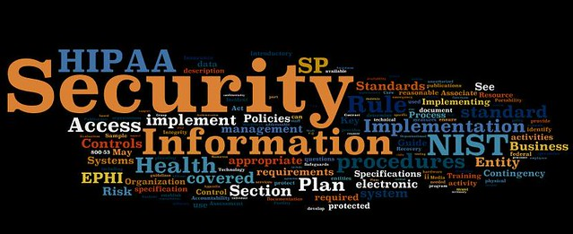
Federal and state laws generally require that we:
Maintain administrative, physical and technical safeguards to protect patient and other sensitive information
Ensure the confidentiality, integrity and availability of information
Identify and protect against reasonably anticipated threats to information
Protect against impermissible uses and disclosures of information
March 2021

Slide 5
Examples of Sensitive Information
Protected Health Information (PHI) is information about an individual’s past, present, or future physical or mental condition, treatment or payment for health care
Name
Demographic information
Diagnosis information, CPT codes
Medical Record Number
Insurance information
Personally Identifiable Information (PII) is information that can be used to identify an individual, either alone or when combined with other information
Name
Social Security Number
Credit card
Driver’s license
Passport Number
March 2021

Slide 6
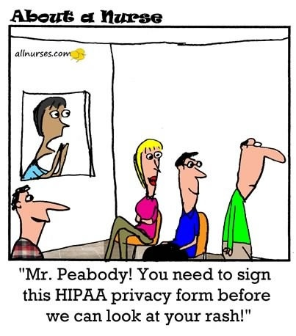
ONLY USE AND SHARE THE MINIMUM AMOUNT OF INFORMATION NECESSARY TO ACCOMPLISH YOUR INTENDED PURPOSE.
REMOVE IDENTIFYING OR SENSITIVE INFORMATION IF AT ALL POSSIBLE

Slide 7
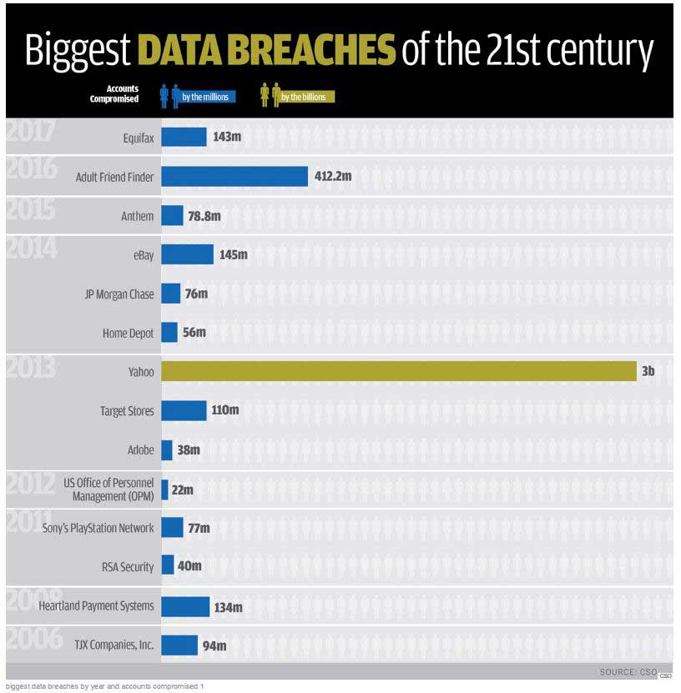
As a general rule, unauthorized acquisition, use, access or release of sensitive information constitutes a breach under law
We must notify:
The patient/impacted person
Federal and state government
The media (if >500 clients’ data)
A healthcare data breach comes with a hefty price tag—$7.13 million on average in 2020

Slide 8
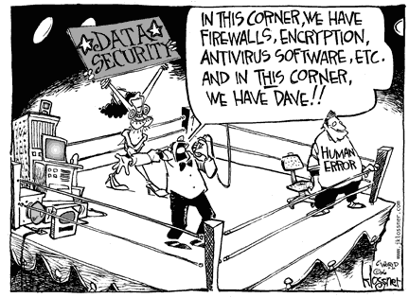
What you can do to protect sensitive information

Slide 9
Use Strong Passwords
Strong passwords are a first line of defense to keep information safe from compromise.
Never share your password or write them down where they can be seen. You are accountable for any actions taken with your credentials.
Prospect Password Requirements include:
Be a minimum length of ten (10) characters
Contain a combination of upper and lower-case letters, numbers and special characters
Not be a dictionary word, proper name, or based on obvious personal information, names of family members, pets, etc.
Consider a unique pass phrase:
14A&A413Mu$keteers!
e@rLYaL2heimer$
BornInTheU$@theB0$$
There1sNo$po0n

Slide 10
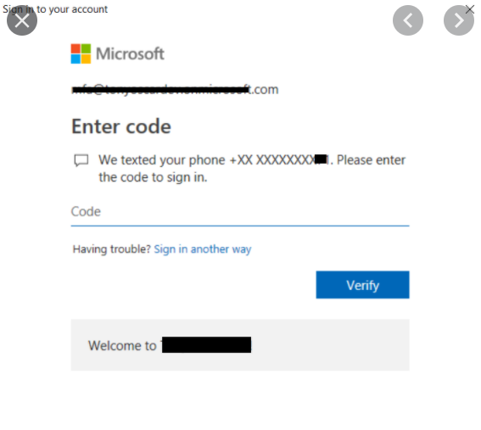



Use MFA To Access Systems
MULTI-FACTOR AUTHENTICATION (MFA)
Adds a layer of security by requiring you to provide two or more credentials in order to authenticate your identity, such as a token, numerical code, or biometric.
Prospect Medical has two MFA tools
Microsoft Authenticator- to access Microsoft Office 365
Duo Security - to access Prospect resources that have been deemed “more sensitive”
If you are not enrolled in MFA, contact your IT Administrator to sign up!

Slide 11

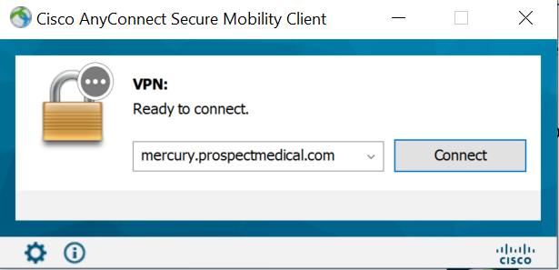
Access Systems Remotely Through An Approved VPN
A Virtual Private Network, or VPN, creates a secure and private tunnel to access Prospect systems from public internet connections.
All staff must use Prospect’s approved VPN when accessing Prospect systems remotely (from home or when traveling)
Connecting to the VPN:
Click on the CISCO icon on your toolbar
Click connect on Cisco pop-up
Enter your Microsoft user name and password
Enter the security code received on your secondary device

Slide 12
Straight from the Headlines . . .
Hospital employee’s unencrypted stolen laptop with patient information leads to $1 million settlement
Only use Prospect-owned/managed devices to send or store sensitive or proprietary information
Prospect devices include encryption to protect sensitive data
Devices include:
Workstations
Laptops
Tablets
Smartphones
Personal devices only may be used to access web-based email

Slide 13
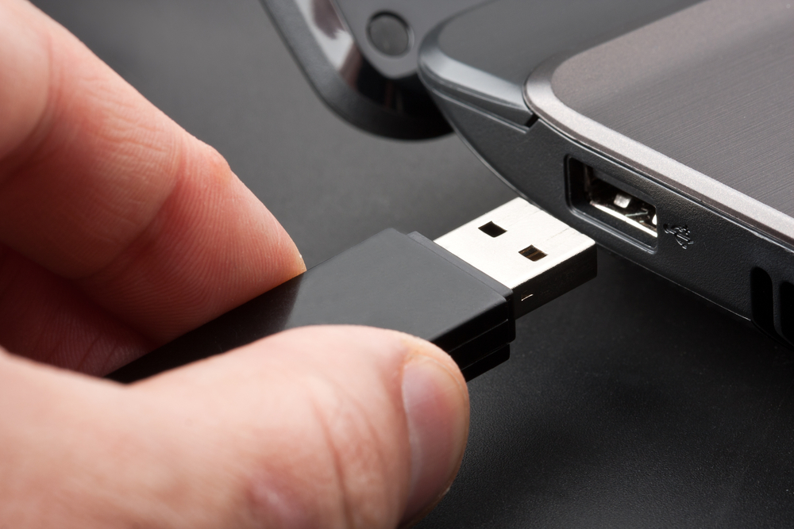
Don’t Store Sensitive Data on Removable Devices
Risks with Removable Devices
Straight from the Headlines . . .
Removable devices (flash drives, thumb drives, CDs) are easily lost or stolen
Malicious software can be installed on removable devices and infiltrate the network
Health System fined $3 million for loss of unencrypted flash drive and laptop with patient health information

Slide 14
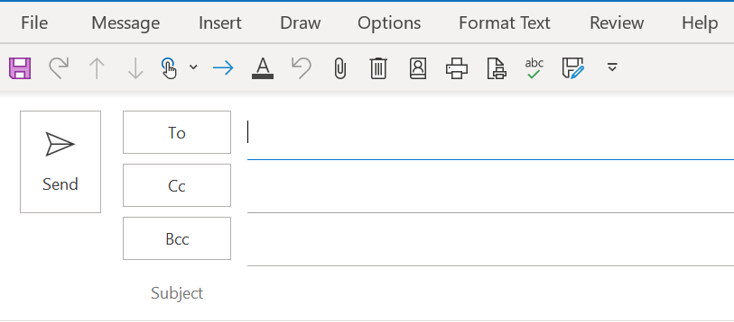
Encrypt Emails Containing Sensitive Information
It is our policy that emails containing sensitive information must be encrypted to safeguard from potential compromise.
Here are examples of how to encrypt email on Office 365:
Click “Options” and then click “Encrypt”
Type “Secure” in the Subject line
OR
“Secure”

Slide 15

Check the Email Address Before You Hit Send
Are you using auto-populate?
Did you double check the email address?
Are you sending to a group?
  Has anyone left the group?
  Are all the addresses still accurate?
  Is it necessary to “Reply All”?
  Are you sending an attachment, such as an excel spreadsheet, with hidden tabs that may contain sensitive information?

Slide 16
Breach or Not?
An employee in the billing company sent an email with an attachment that contained patient information for patients to an incorrect email address. The email appeared active, but attempts to contact the individual associated with the email address were unsuccessful.
This event was a breach. Although the transmission of the PHI to the incorrect email address was inadvertent, the PHI was sent to an individual who was not associated with the group or its business associates who could have accessed the PHI. The physician was required under law to notify patients and the government.

Slide 17
Be Careful of Phishing Schemes
Look for the [EXTERNAL MSG] banner on any email. Email with this banner may pose a greater risk to our system
These messages could include:
  Spam – unsolicited bulk email. Do not reply to or forward spam messages
  Phishing Scams – Email pretending to be from a trusted source but used to obtain passwords or other confidential data
PHISHING SCAMS CAN BE COSTLY . . . . A health insurer settled for $16 million after at least one employee responded to phishing emails that were exploited by hackers to gain access to its systems and data.

Slide 18
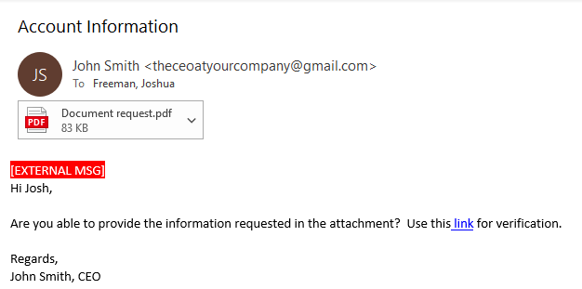
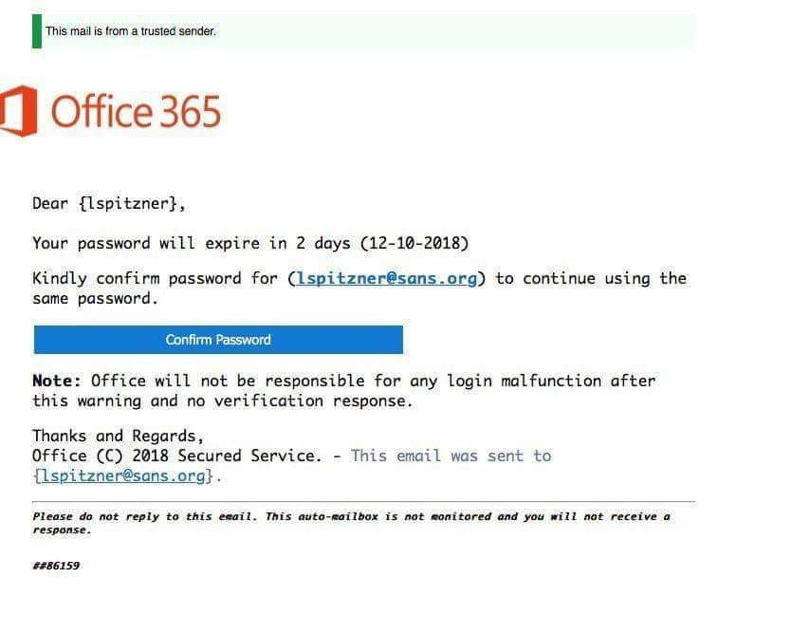
Phishing Email Examples
Attachments: When an attachment comes
from someone you don’t know or if you
weren’t expecting the file, make sure it’s
legitimate before opening
Look for the [EXTERNAL MSG]
notification; this will help determine
if a request is legitimate
Links: If you hover your mouse
over the link it shows you the URL
you will be taken to. Do not click on a link
unless you’ve verified that it’s legitimate
Always check with your IT Administrator before responding to emails requesting your password
Beware of these elements!

Slide 19
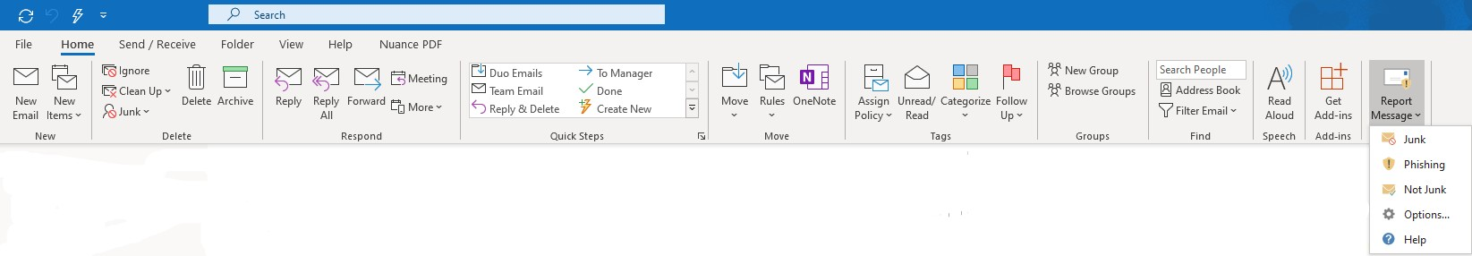

Report Suspicious Emails
If it looks suspicious, don't open it! What is suspicious?
Not work-related
Attachments not expected
Attachments with suspicious file extension (.exe, .vbs, .bin, .com, .scr, or .pif)
Unusual Web link
Unusual topics in subject lines

Slide 20
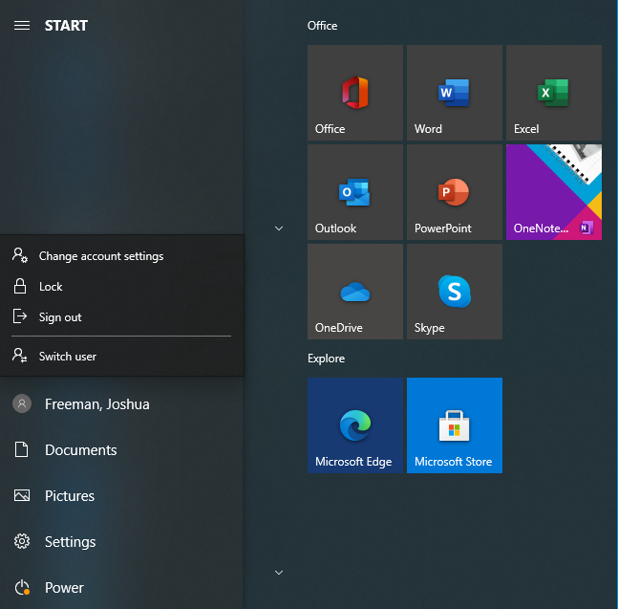
Log Off and Lock Up
To lock your computer, first click on the windows icon on
The lower left hand side of your computer screen
Log-off before leaving a workstation unattended
Do you have a screensaver? Does the screensaver lock and require you to enter your password for access?
Lock-up offices, cabinets and/or drawers that contain sensitive information
Don’t leave devices or documents with sensitive information unattended (for example, in the cafeteria, parking lot, copier or your car)
Notify IT about workstations or storage devices that are no longer in use (IT will “wipe” the equipment per HIPAA standards)
After clicking the windows icon,
select your profile and click the lock or
sign out feature

Slide 21

Use Social Media Responsibly
Do not take photographs, videos or recordings of patients or patient information for non-clinical purposes.
Never post patient images, including body parts, or other patient information on social media sites without a HIPAA authorization.
Don’t talk about patients on social media, even if you are not using patient names
Refer to Prospect’s Social Media Policy for more information about appropriate uses of social media.
From the Headlines . . .
Response to Yelp Review Costs Dental Practice Agrees to Fine and Two Years of Monitoring to Settle HIPAA Complaint

Slide 22

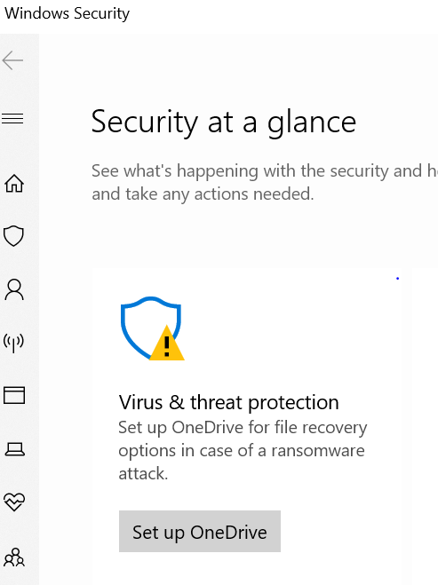
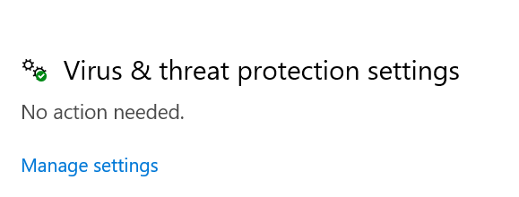
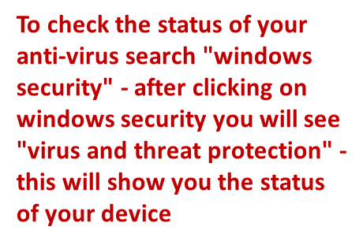

When traveling for work, do the following:
Let your IT Administrator and the Prospect IT Security department know when you are traveling outside of Prospect hospitals and facilities so they can enhance security monitoring of your account access.
Check with your IT Management to ensure your laptop and cell phone have appropriate security safeguards, including anti-virus protection.

Slide 23
If you see something, say something!
Report any suspicious activity immediately.
Suspicious activity may include but not limited to the activities below:
You opened an email attachment from someone you thought was a co-worker.
Your system is behaving erratically or very slowly.
You receive numerous emails from sources you do not recognize.
You lost your cell phone, laptop or flash drive.
You observe what you feel is a physical security issue (unlocked communications closets, unattended computers that are not locked, USB or other media with no identifiable owner, records or other documents with sensitive information left unattended).
Suspicious activity should be reported to your IT Director or call the IT Help line at: 855-764-1253.

Slide 24
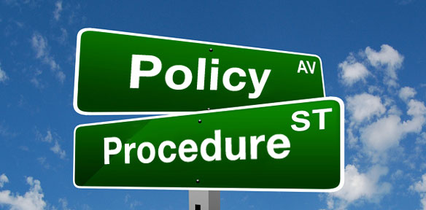
Prospect IT Appropriate Use Policy
The purposes of this policy are
to provide guidance regarding the appropriate use of Prospect information technology (“IT”) equipment, systems, and data; and
(ii) to ensure that the information technology infrastructure promotes and provides a safe, secure, and reliable computing environment to support Prospect’s patient care, administration and research needs.
The policy applies to the use of the Prospect network, even when accessed remotely and/or from a non-Prospect owned or managed computer.
Policy Highlights include:
What is sensitive information and how can you protect the information
Your role in using IT services, systems, equipment
safely, securely and appropriately
Resources to secure sensitive information
References to HIPAA and other privacy and security policies
Guidance on reporting issues or policy violations
March 2021

Slide 25
Prospect Resources
IT Help Line: TBD
Compliance and Ethics Action Hotline: 1-844-PMETHIC (844-763-8442)
Prospect Code of Conduct
Prospect IT Appropriate Use Policy -

Slide 26

PRIVACY AND SECURITY ARE SHARED RESPONSIBILITIES
We all are responsible to our patients, their families, our colleagues and staff to ensure we properly safeguard the information that we use, store and share.

