Slide 1

HIPAA PRIVACY,
BREACH NOTIFICATION,
AND SECURITY
Presented by:
Compliance Department

Slide 2

Fundamental Philosophy
Always ask yourself, “How would I want my parent’s
information or my child’s information, to be treated?”

Slide 3


Consequences for Non-Compliance
Penalties can be imposed on entity or individual:
 HIPAA Criminal Penalties
◦ Up to $250,000 fine and 10 years imprisonment
 HIPAA Civil Penalties
◦ Up to $1,500,000 fine
 Corrective and disciplinary actions for policy violations
 State laws also impose penalties and deadlines
(15 days for Hospitals to report in CA)

Slide 4

HIPAA Three Rules
Privacy Rule
Breach Notification Rule
Security Rule

Slide 5

HIPAA Privacy Rule
Defines “Protected Health Information”
Obligates “Covered Entities” like hospitals and Medical
Groups to protect PHI
Outlines individual’s rights for PHI

Slide 6

What is Protected Health Information or PHI
Two elements required for PHI:
▫ Medical Information: Information related to a
patient’s health, condition, treatment or payment
▫ Identifying Information: Includes at least one of 18
personal identifiers
Any form: written, spoken, or electronic

Slide 7
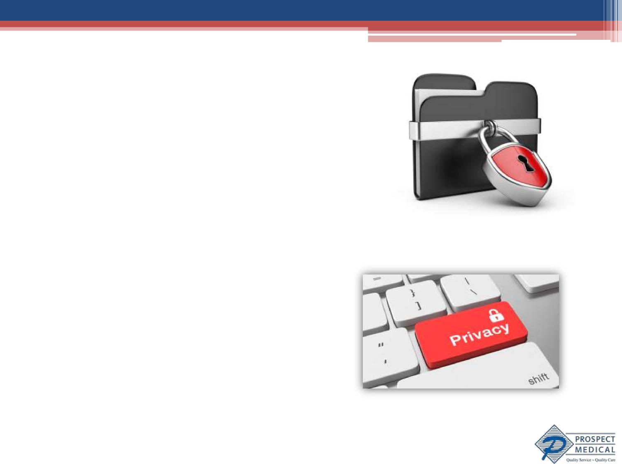
The Many Forms of PHI
Paper copies
Telephone calls, voice mails, text messages, emails
& faxes
Photos/videos
Verbal communications

Slide 8

Key Concept:
Minimum Necessary Principle
For certain disclosures (e.g., disclosures to health
plan for payment or pursuant to subpoena) must
limit disclosure of PHI to minimum necessary
Restrict access to PHI for job related reason only

Slide 9

Basic Tenets of HIPAA
 Unless use or disclosure of PHI falls within an
exception, “Authorization” required
 Two main exceptions:
Treatment, payment and operations = “TPO”
Public interest disclosures

Slide 10
TPO Exceptions to Authorization Requirement
No patient authorization required to disclose PHI for:
Treatment: Hospital faxes medical record to
attending physician who plans to continue to treat
patient
Payment: Hospital emails health plan medical
information to ensure payment for services
Operations: Hospital mails discharge paperwork to
third party vendor for case management services

Slide 11


Allowable public interest disclosures
Examples:
 CMS or CDPH audits
 Court signed subpoenas
 Serious threat to health or safety of individual
 Certain law enforcement requests
NOTE: THESE ARE NARROWLY DEFINED UNDER HIPAA
Check with COMPLIANCE FIRST

Slide 12

Authorizations
Most other disclosures require a valid written authorization from the individual
Authorization is not a simple oral or written “OK” by patient
Authorization is two-page form with required

Slide 13

Patient Rights re PHI
 Right to receive notice of uses and disclosures of PHI –
Notice of Privacy Practice
 Right to inspect and obtain copy of PHI
 Right to request amendments of PHI
 Right to request restrictions on uses and disclosures of
PHI
 Right to obtain accounting of disclosures
 Right to complain
 Right to be notified of a breach
Check with supervisor, Privacy or Compliance

Slide 14

No Retaliation
Retaliation against patient or employee for reporting HIPAA violation is strictly prohibited

Slide 15

HIPAA Breach Notification Rule
 Unauthorized acquisition, access, use, disclosure of PHI compromising its security or privacy
 We must notify:
◦ The patient
◦ Federal and State government
◦ The media (if >500 clients’ data)
◦ The health plan (if we are a Business Associate)

Slide 16


Breach from Lost, Stolen or Misdirected Information
A privacy breach can occur when information is:
 Physically lost or stolen
 Electronically lost or stolen (e.g., hacker)
 Snooped on (e.g., celebrities, friends/relatives)
 Misdirected to others
 Wrong discharge paperwork
 Faxes meant for physician go elsewhere

Slide 17
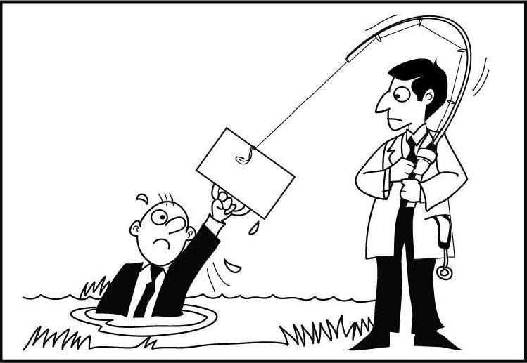
'Business Associates are on the hook for HIPAA violations."

Slide 18

In Case of Breach
Notify Compliance immediately
Compliance must retrain or obtain confirmation of retraining
For Paper PHI
Ask recipient to return PHI or confirm in writing it was destroyed and not otherwise copied/distributed
For Electronic PHI
Ask recipient to confirm in writing it was permanently deleted from user account and Company server
Perform a root cause analysis and take corrective action such as: correct wrong number or e-mail, revise policy

Slide 19

HIPAA Security
 Rule requires technical, physical and
administrative safeguards to protect ePHI
 Technical safeguards:
Never open suspicious emails, attachments or links;
notify IT immediately
Don’t share your username or password and don’t
make it easily accessible
If you must save PHI, save it on the shared drive not
your local C drive

Slide 20

HIPAA Security
 More technical safeguards
Watch for phishing expeditions like spoofed websites or
suspicious emails and attachments
Don’t disclose PHI to unknown persons & double-check if
someone says they’re from the intermediary or the
government
If electronically sending PHI do so securely, e.g., encrypted
email or secure FTP
If you think your workstation has been compromised, e.g.,
downloading a virus, notify both IT and Compliance
immediately

Slide 21


HIPAA Security
 Physical safeguards:
Report doors that are unlocked allowing outsiders
access to PH
Report workstations or storage devices that are no
longer being used
Notify IT to reclaim the equipment
IT will “wipe” the equipment in accordance to HIPAA standards
Report keys or keypads that are not changed

Slide 22
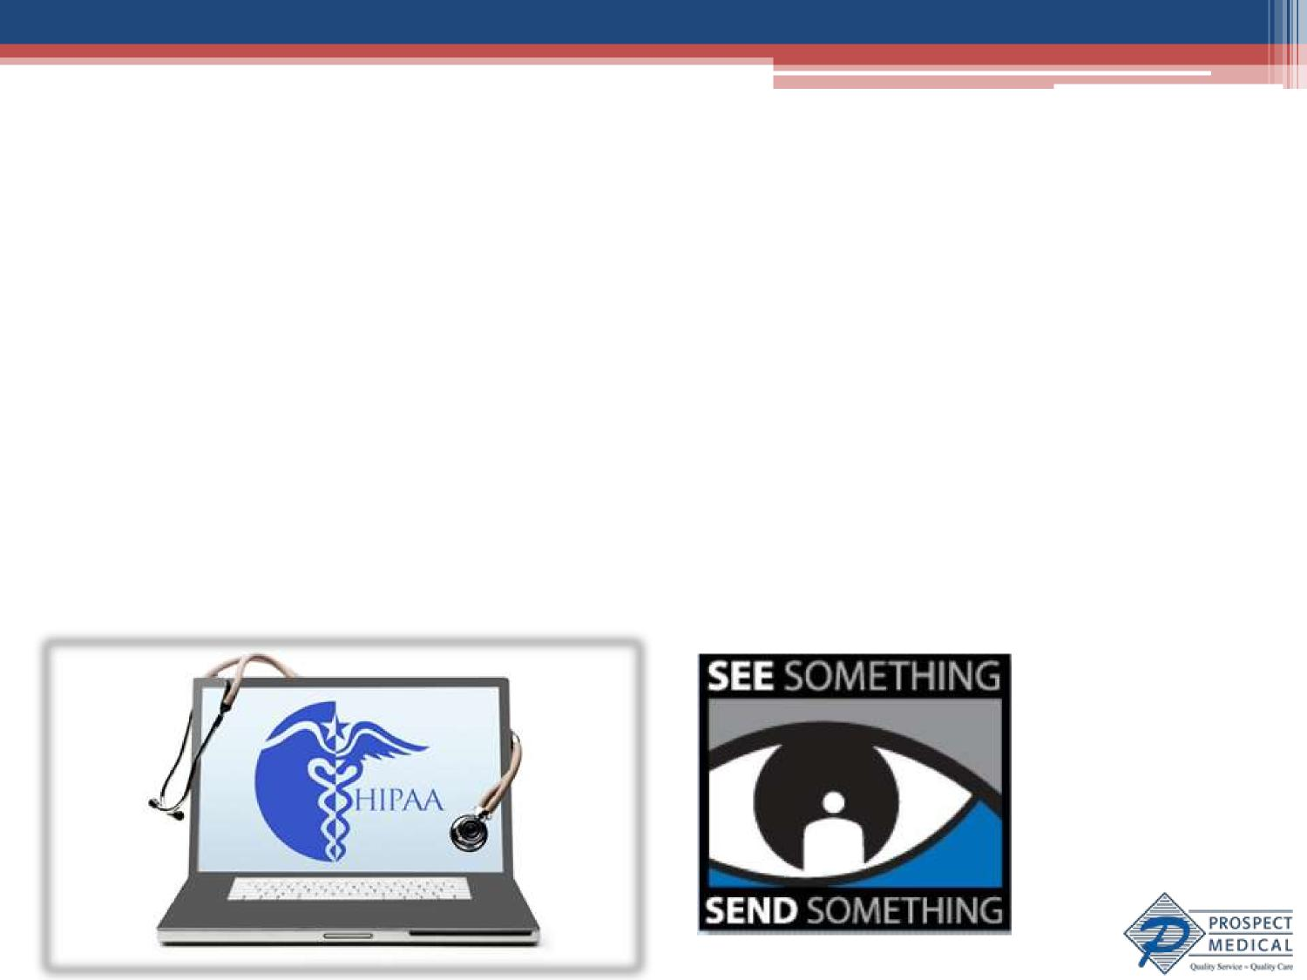
HIPAA Security
 Administrative safeguards:
Report any staff who access any PHI without job
related reason
Report any PHI access level that is excessive or not
job related

Slide 23

HIPAA Safeguards
Verbal: Keep your voice down and direct your
conversation to the patient
Paper: Return, lock it up or shred it
Workstation: Encrypt you laptop, don’t share your
username or password, lock up and log off, save PHI
to shared drive
Phone Calls, Emails and Faxes: Check the number
or address; notify supervisors if received by
unintended recipient

Slide 24
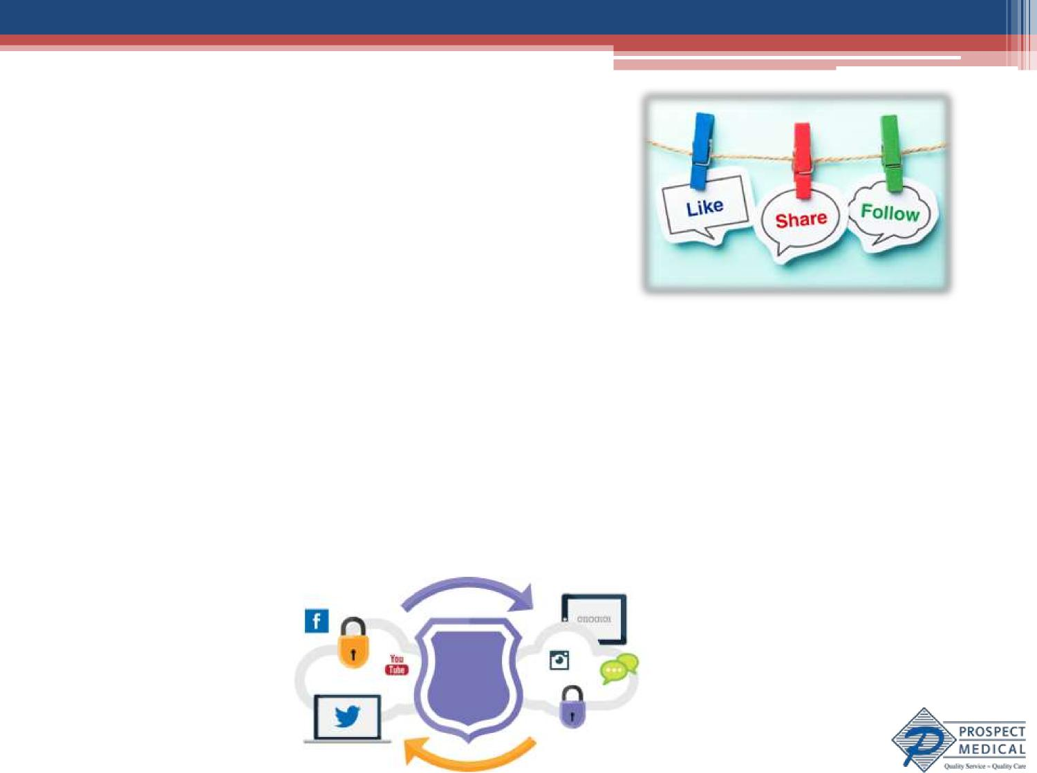
HIPAA & Social Media
What is Social Media?
Social Networks (Facebook, Twitter, etc.)
Third party rating sites (Yelp)
Multimedia host sites (Youtube, Snapchat)
Discussion Forums (Reddit)
Collaborative Information Systems (Wikipedia)

Slide 25

HIPAA & Social Media
Social Media Facts:
Posting PHI is almost always a HIPAA breach- Don’t do it.
▫ The social media company, your friends, and your friends’ friends have no right to view the PHI
Even if the patient is your social media friend or
informally OK’d your post, that is not a formal
HIPAA authorization
Even if you didn’t name the patient, if you gave
enough details so public could identify patient,
your post is PHI

Slide 26
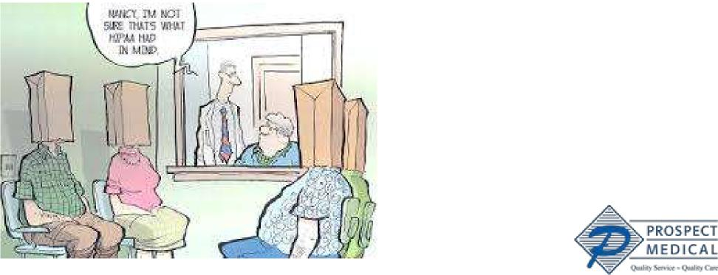
HIPAA & Social Media
Social Media Do’s
Do use social media during your off-work time
Do discuss the conditions of your employment
Do exercise other rights protected by Section 7
of the National Labor Relations Act

Slide 27


HIPAA & Social Media
Social Media Don’ts
Don’t use or disclose PHI or discuss patients even in
general terms on line
Don’t post photos of inside Hospital because PHI
could be in the background
Don’t post anything about work if you would be
embarrassed if your supervisor found out

Slide 28

Compliance Duties
As employees you have the following duties:
Understand compliance training and ask
questions if you don’t understand
Follow compliance rules
Notify Compliance if other staff violate these rules
* Violation of these duties is subject to discipline up to and including termination

Slide 29
Contacts:
To report compliance concerns:
Hotline 1-844-PMETHIC or 1-844-763-8442
For questions or additional information:
Michelle Amador, Vice President- Compliance
Prospect Health Compliance & Privacy Officer: (714) 683-2583
Reshma Thomas, Sr. Compliance Director & PMS Compliance & Privacy Officer: (714) 683-2589

